Slide 1

Unit-5 Domain Specific Applications of IoT
Internet of Things (IoT)
DU #2101CS631
Prof. Bhushan D. Joshi
Computer Engineering Department
bhushan.joshi@darshan.ac.in
+91 8485979997

Slide 2
Domain Specific applications of IoT
Home automation, Industry applications, Surveillance applications & Other IoT applications
IoT Application Architecture
Introduction to Python And Different IoT tools
Developing IoT application through IoT tools
Developing sensor-based application through embedded system platform
IoT and Cloud computing

Slide 3
IoT Applications
Section - 1

Slide 4
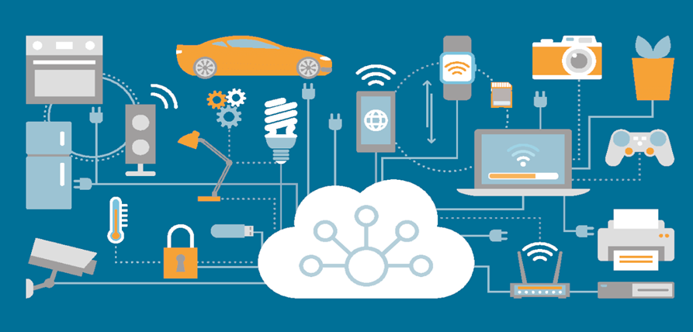
Applications with IoT
Using IoT we can build many applications but here, few IoT Applications will be discussed.
We will cover following topics of the IoT applications.
Overview – General Practice
Importance – Why we need?
Requirements – Materials and Facility
Architecture – Functional Block Diagram
How it works – General Working of IoT Applications
Before we explore them one by one, let’s understand the common architecture of the IoT applications.
Notes:
4

Slide 5
Common Architecture for IoT Application
This “Local Analysis, Processing and Controlling” section may not be there in many IoT solutions
All Kind of Sensors,
GPS, etc.
In House Monitoring or Care Taker Team Members
Local Monitoring
Remote Monitoring or Care Taker or Emergency Help Team Members.
Sensor Nodes
Remote Monitoring
Link
Controller Node
Fog / Local Computer
Cloud Services
Link
Internet
Internet
Link
Internet Gateway
Actuator Nodes
Central and Remote
Storage/Analysis
Data Analytics
Within Organization for
Local Analysis, Processing and Controlling
Relays, Alarms, Motors, Actuators, Light Indicators, etc.
Research / Decision Making
Where, Link: Wire, LAN, Wi-Fi, or Bluetooth Connectivity
Notes:
5

Slide 6
Common Architecture for IoT Application
This Local Analysis, Processing and Controlling section may not be there in many IoT solution
Relays, Alarms, Motors, Actuators, Light Indicators, etc.
In House Monitoring or Care Taker Team Members
Local Monitoring
Remote Monitoring or Care Taker or Emergency Help Team Members.
Actuator Nodes
Remote Monitoring
Link
Controller Node
Fog / Local Computer
Cloud Services
Internet
Internet Gateway
Link
Internet
Link
Sensor Nodes
Central and Remote
Storage/Analysis
Data Analytics
Within Organization for
Local Analysis, Processing and Controlling
All Kind of Sensors, GPS, etc.
Research / Decision Making
Where, Link: Wire, LAN, Wi-Fi, or Bluetooth Connectivity
Notes:
6

Slide 7
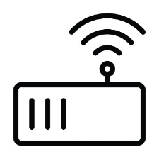
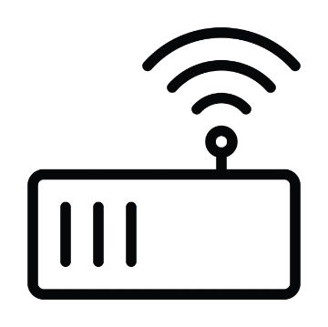
How it works?
Sensor / Actuators
All the sensor and actuator nodes should be placed at appropriate place.
The sensor and actuator nodes should have proper connectivity with controller nodes or direct to the cloud server.
The sensor nodes sends the sensed data to the controller nodes or directly to the cloud server.
The controller node:
Collects the data from all the sensors.
Apply some business logic on it as per the requirements
Send it to the Fog or local computer, or directly to the cloud server.
Sensor Node
Actuator Node
Gateway
Actuator Node
Sensor Node
Sensor Node
Notes:
7

Slide 8
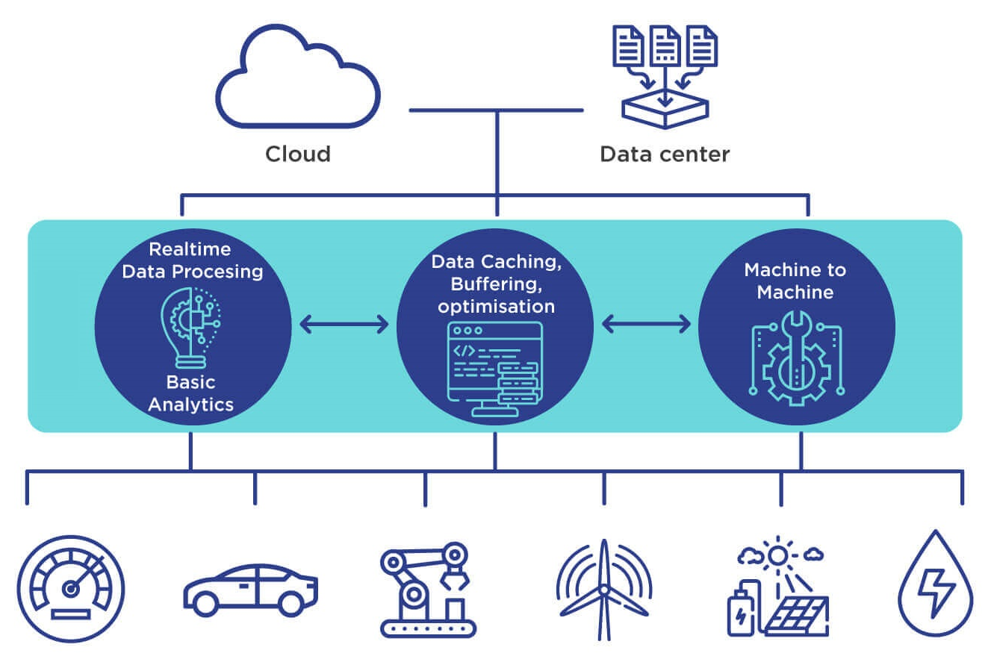
How it works?
Fog Computing
All the controller nodes should have connected with the Fog or local computer network, or directly to the cloud server via Internet.
Fog or local computer
Receives all the data from all the controller nodes,
Execute some business logic and
Do analysis on the collected data, and
Send the filtered limited data to the cloud computer as well as
Send the alert messages to the local team.
The Fog computer should have Internet connectivity for the cloud connectivity.
Notes:
8

Slide 9
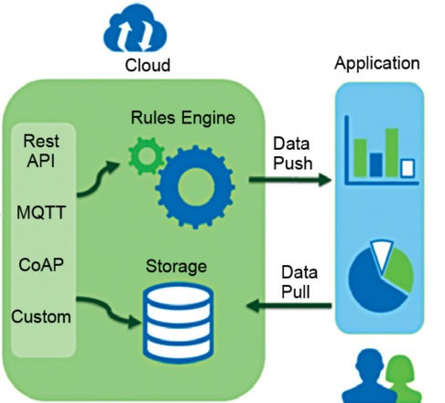
How it works?
Cloud Computing
All the in House Monitoring team members can access status of all the sensors from the Fog/Local computer.
The cloud
Stores all the data received from the Fog/Local computer or directly from the sensors,
Execute some business logic and
Do analysis on the stored data.
All those who have rights to access the cloud data can get desire information from it, like
Remote monitoring team members,
Data analytics
Notes:
9

Slide 10
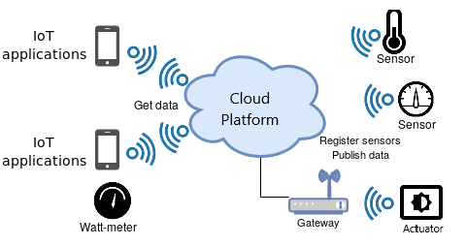
How it works?
Data Analytics & Action
The care taker and data analytics teams may execute corrective action based on the analyzed data.
They may
Send command to the local computer or to the actuators directly and
Broadcast alert messages to the concern persons.
All the actuator nodes receives command from the cloud directly or from the controller or local computer.
The “Local Analysis, Processing and Controlling” section may not be there in many IoT solutions.
Notes:
10

Slide 11
Health Care Application
Section - 2

Slide 12
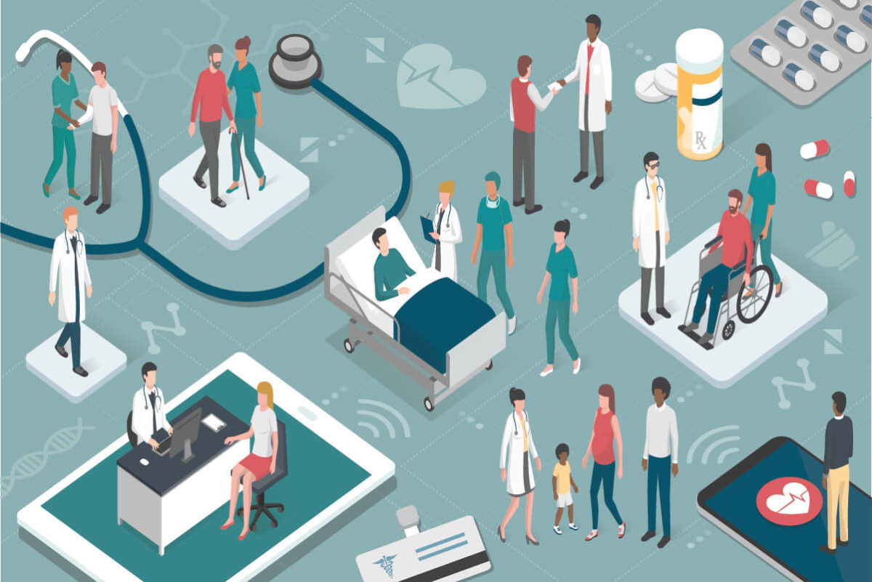
Healthcare Application with IoT
Overview
The healthcare sector consists of medical and related goods and services.
Healthcare sector provides medical services for maintaining or improving health via
Prevention
Diagnosis
Treatment
Recovery or cure of disease, illness, injury, and other physical and mental harms in people.
Healthcare sector is much diversified and is full of opportunities in every segment.
Notes:
12

Slide 13

Healthcare Application with IoT
Overview
Healthcare is delivered by health professionals.
Medicine
Dentistry
Pharmacy
Nursing
Psychology
And other health professions are all part of health care.
Healthcare has become one of India’s largest sector in terms of revenue and employment.
Notes:
13

Slide 14
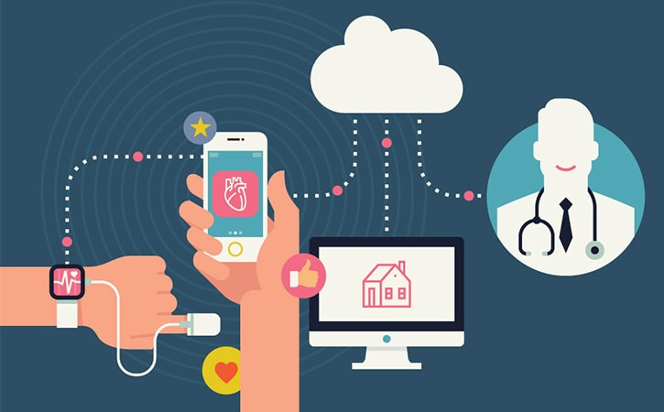
Healthcare Application with IoT
Importance
Before Internet of Things, patients’ interactions with doctors were limited to visits.
There was no way doctors or hospitals could monitor patients’ health continuously.
IoT enabled devices have made remote monitoring in the healthcare sector possible.
IoT helps
To keep patients safe and healthy,
Empowering physicians to deliver superlative care.
Notes:
14

Slide 15
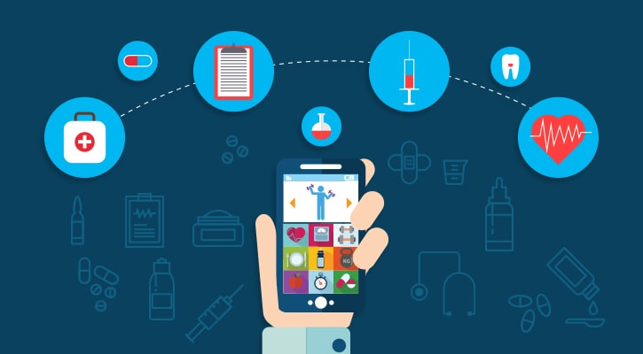
Healthcare Application with IoT
Importance
Remote monitoring of patient’s health helps in
Reducing the length of hospital stay and
Prevents re-admissions.
IoT has applications in healthcare that benefit to
Patients
Families
Physicians
Hospitals and
Insurance
Notes:
15

Slide 16
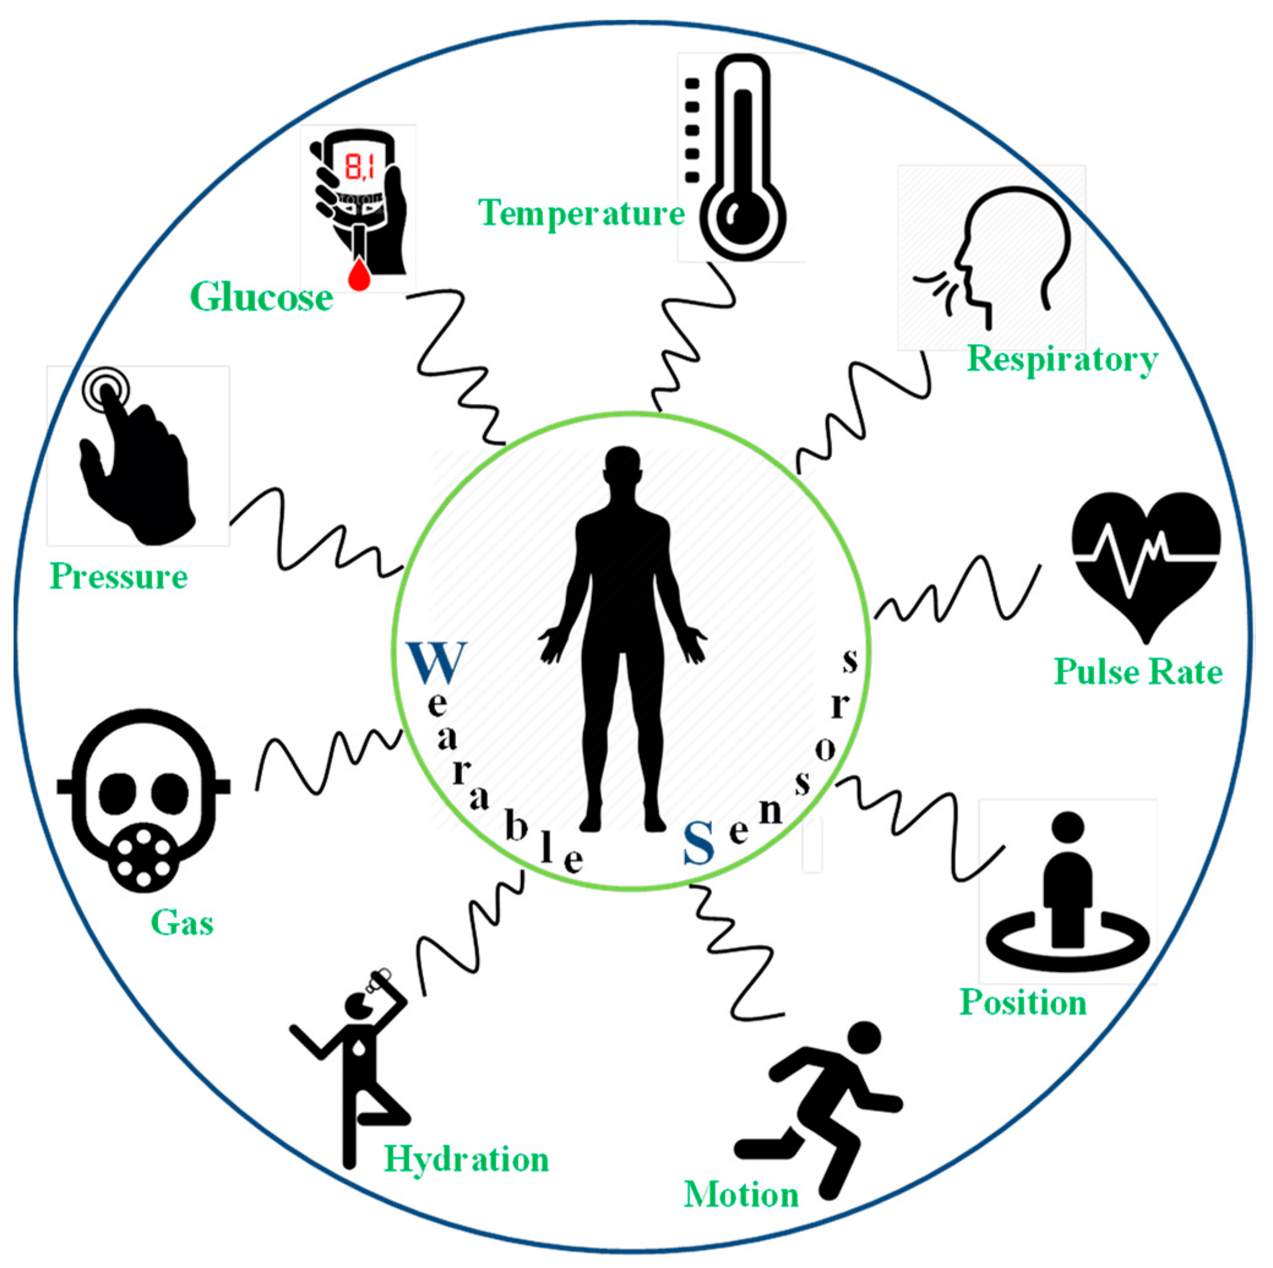
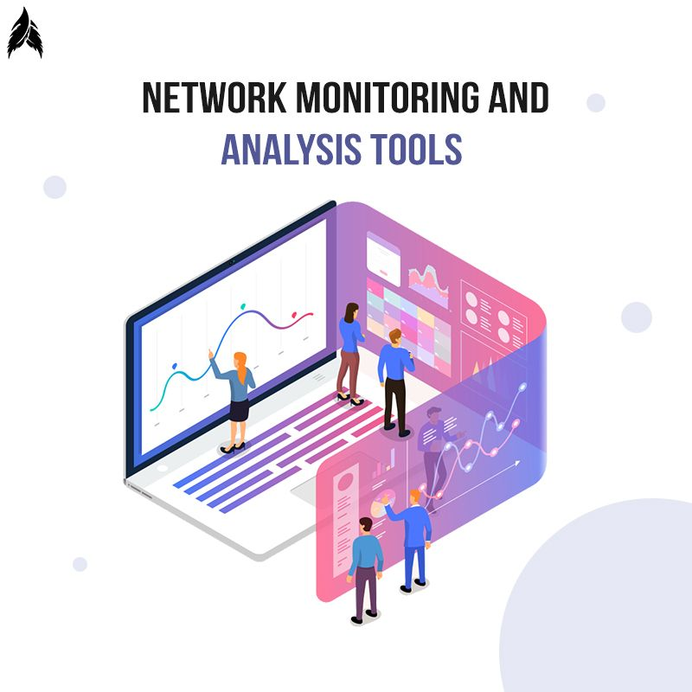
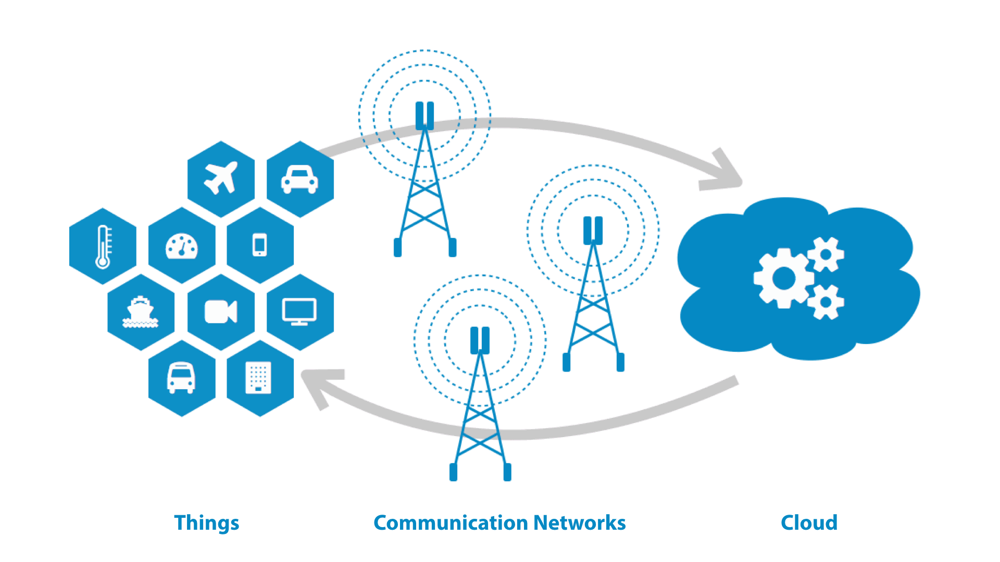
Healthcare Application with IoT
Requirements for IoT Setup
Sensors
Heartbeat Sensor
Oxygen Level Sensor
Glucose Level Sensor
Controller
ESP8266 Node MCU or
Arduino Uno with Wi-Fi or Network Shield
For Monitoring and Analysis
PC
Mobile
Tablet
For Fog Computing
Raspberry Pi or
PC
LAN and WAN Connectivity
Router and Switches
Wireless Access Point
Cloud Services
Notes:
16

Slide 17
Healthcare Application with IoT
Architecture
Nursing Staff and Doctors
Nursing Staff and Doctors
Heartbeat Sensor Node
Local Care Taker Monitoring
Remote Care Taker Monitoring
Internet
Wi-Fi
Patient Wise Node
Wi-Fi / LAN
Oxygen Sensor Node
Wi-Fi
Controller Node
Wi-Fi LAN
Fog Computer
Cloud Services
Internet
Data Analytics
Internet Gateway
Within Organization for Local Analysis and Processing
Research / Decision Making
Central and Remote
Storage/Analysis
Internet
Wi-Fi
Glucose Sensor Node
Patients Family
Notes:
17

Slide 18
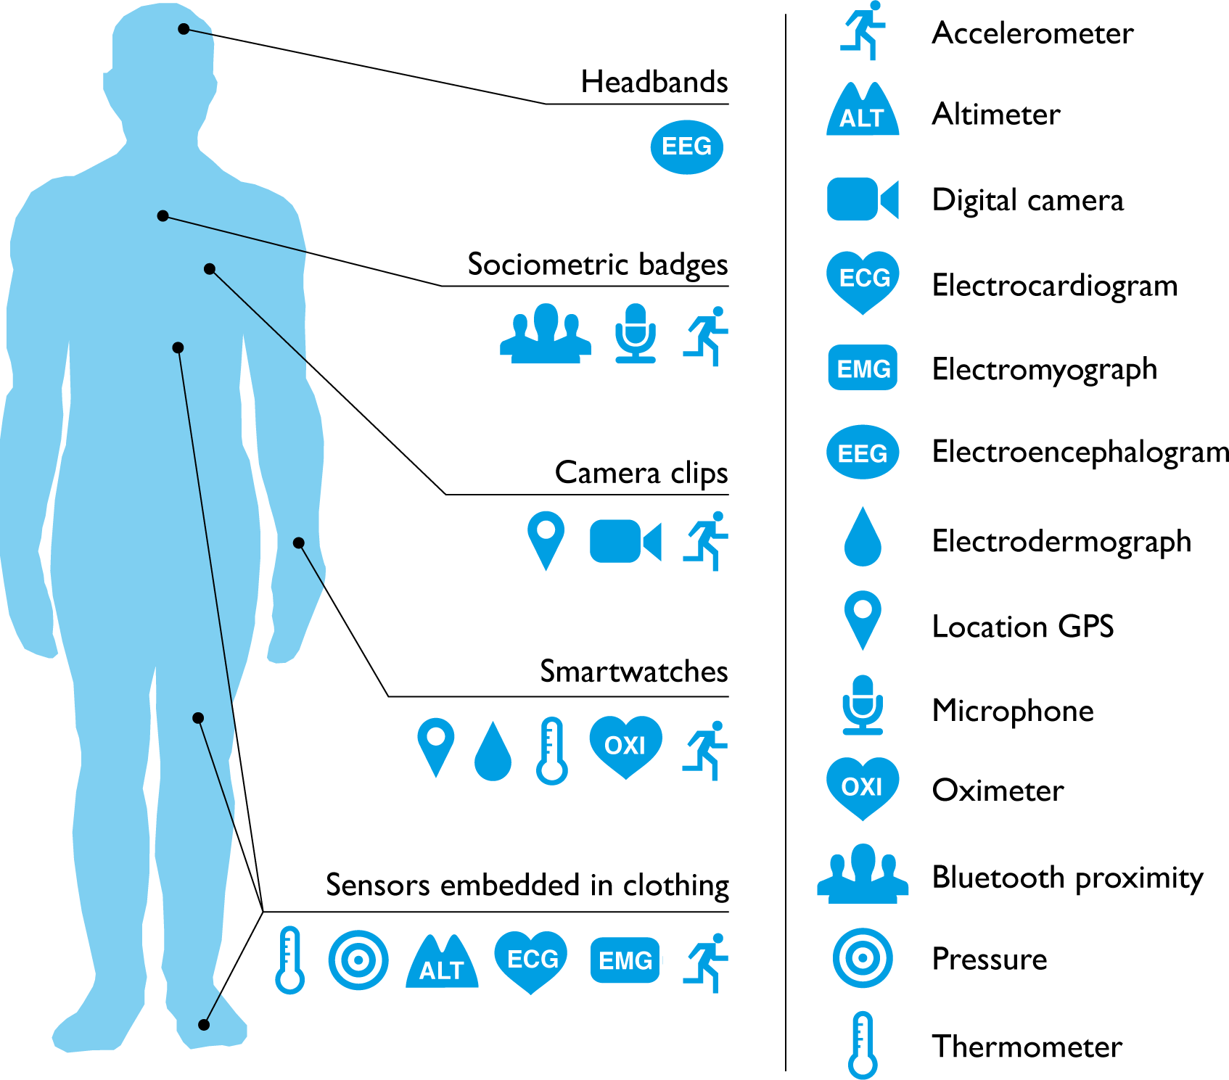
Healthcare Application with IoT
How it works?
All the sensor nodes should be placed on patient body, either direct or using wearables.
The sensor nodes should have Wi-Fi connectivity with a controller node of the patient.
The sensor nodes sends the sensed data to the controller node.
The controller node collects
The data from all the sensors,
Apply some business logic on it as per the requirements and
Send it to Fog computer.
All the controller nodes of all the patients should have connected with the Fog computer network.
Notes:
18

Slide 19
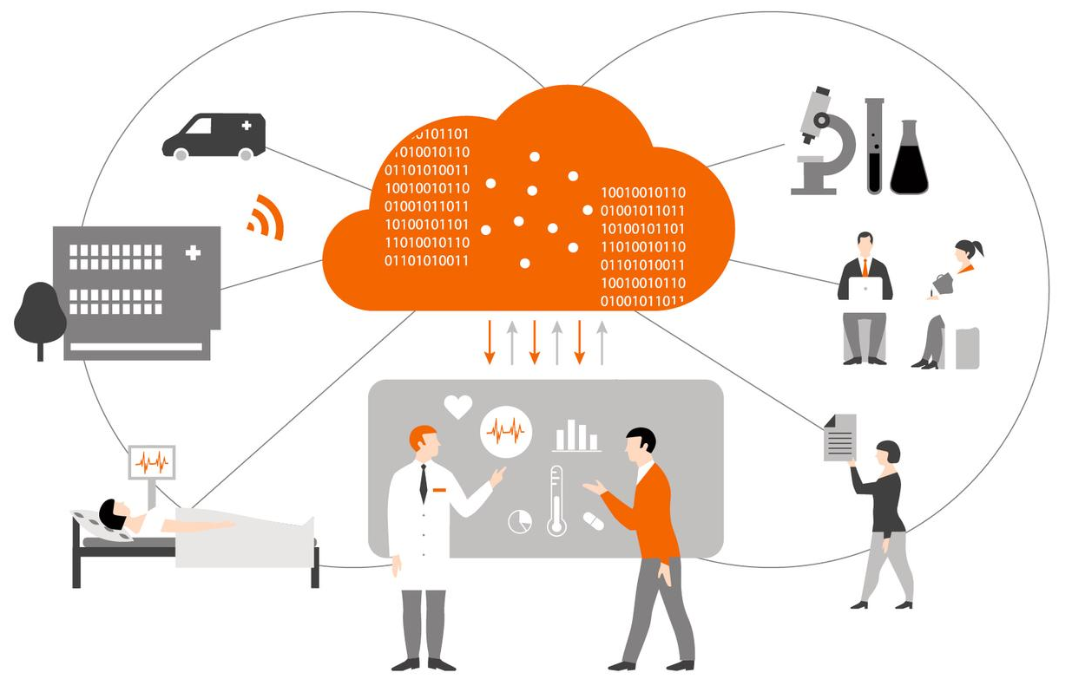
Healthcare Application with IoT
How it works?
Fog computer
Receives all the data from all the controller nodes
Execute some business logic and
Do analysis on the collected data, and
Send the filtered limited data to the cloud computer as well as
Send the alert messages to the care taker team (nursing staff and doctors).
The Fog computer should have Internet connectivity for the cloud communication.
All the local care taker team members can be accessed health status of all the patients from the Fog computer.
Notes:
19

Slide 20
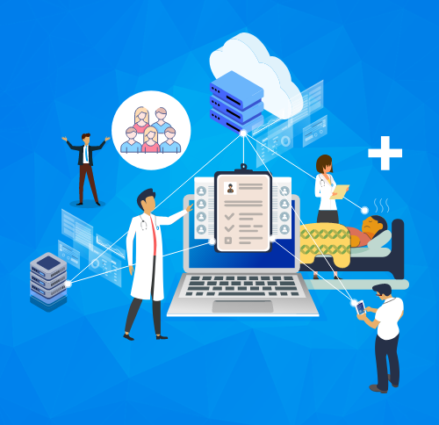
Healthcare Application with IoT
How it works?
The cloud
Stores all the data received from the Fog
Execute some business logic
Do analysis on the stored data
All those who have rights to access the cloud data can get health records of the patients, like
Remote care taker team members
Data analytics team
Patient family members
The care taker and data analytics teams may execute corrective action based on the data and alert messages.
Notes:
20

Slide 21
Healthcare Application with IoT
Summary
IoT has changed people’s lives by enabling constant tracking of health conditions.
Wearables connected devices like blood pressure and heart rate monitoring cuffs, glucometer etc. give patients attention.
On any changes in the routine activities of a person, alert message sends to family members and health service providers.
IoT enables healthcare professionals to be more watchful.
Data collected from IoT devices can help physicians identify the best treatment process.
IoT devices tagged with sensors are used for tracking real time location of medical equipment like wheelchairs, nebulizers, oxygen pumps and other monitoring equipment.
IoT-enabled hygiene monitoring devices help in preventing patients from getting infected.
It also help in asset management like pharmacy inventory control, and environmental monitoring, for instance, checking refrigerator temperature.
Notes:
21

Slide 22
Retail Applications
Section - 3

Slide 23

IoT Application in Retail
Overview
Retail is the process of selling consumer goods or services to end-users for earning a profit.
The retail sectors can be divided into
Food
Clothing & Textiles
Consumer Durables
Footwear
Jewelry
FMCG
Notes:
23

Slide 24
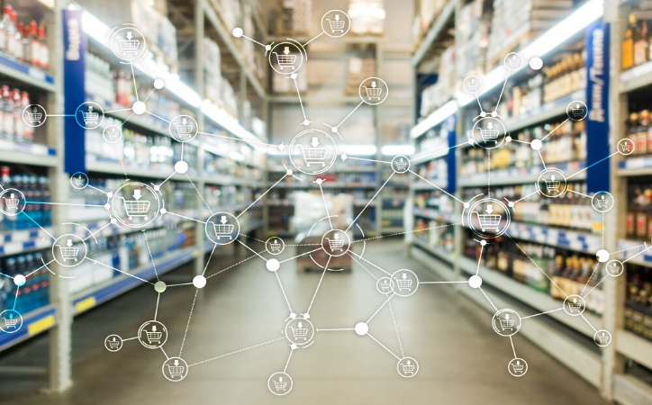
IoT Application in Retail
Importance
In the retail industry customer plays key roll
The retail industry is rapidly transforming with IoT solutions.
IoT is taking the center stage in the sector.
Inventory management has been an expensive and tedious process.
IoT system automatically monitors inventory.
Send alert messages to managers if a certain item is running low or going to expire soon.
IoT devices are also helpful for avoiding
Oversupply
Shortage of goods and
Thefts in stores
Notes:
24

Slide 25
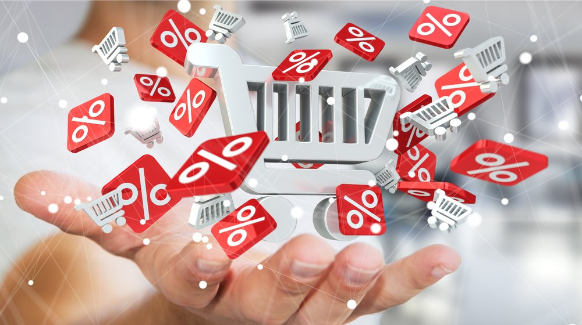
IoT Application in Retail
Importance
Customers are notified about discounts and offers in real-time.
It give data about customer behavior and routes.
IoT helps to increase
Customer loyalty
Boost sales
Offer a personalized experience
Helps to maintain Stock
Notes:
25

Slide 26
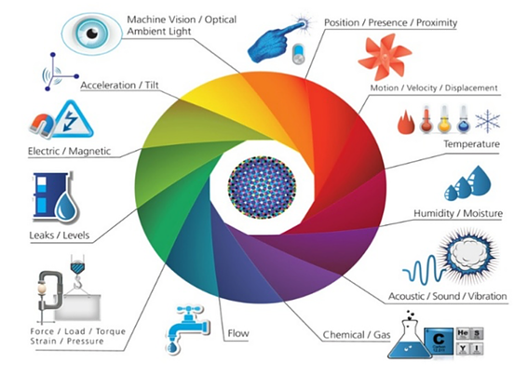
IoT Application in Retail
Requirements for IoT Setup
Sensors | Actuators and Tags
For Monitoring and Analysis
PC
Mobile
Tablet
Touch Sensors
Gas Sensors
Fire Sensors
IR Sensors
Alarm
Water Sprinkler
Beacons
RFID Tag and RFID Reader
Controller
ESP32 MCU or
Arduino Uno with Wi-Fi or Network Shield
LAN and WAN Connectivity
Router and Switches
Wireless Access Point
Cloud Services
Notes:
26

Slide 27
IoT Application in Retail
Architecture
For Inventory Management
For Feedback
On Each Item
On Smart Shelves
Store Manager and Other Staff
Touch Sensor Nodes
RFID Tags
RFID Readers
Wi-Fi
Monitoring System
RIFD Tag Data
Wi-Fi / LAN
Central
Storage/Analysis
For
Safety
Gas & Fire Sensor Nodes
Internet
Controller Nodes
Wi-Fi LAN
Local Server
Cloud Services
Internet
Data Analytics
Internet Gateway
Wi-Fi
Light & Temp. Sensor Nodes
Internet
For
Ambiance
Wi-Fi / LAN
Beacon Data
Within Organization for Local Analysis and Processing
Research / Decision Making
Beacons
Customers
Camera & IR
Sensor Nodes
Alarm & Water Sprinkler Node
Bluetooth
Wi-Fi
For Safety
For In-store Navigation &
Real Time Offers
For In-Store,
Entry-Exit & Parking
Notes:
27

Slide 28
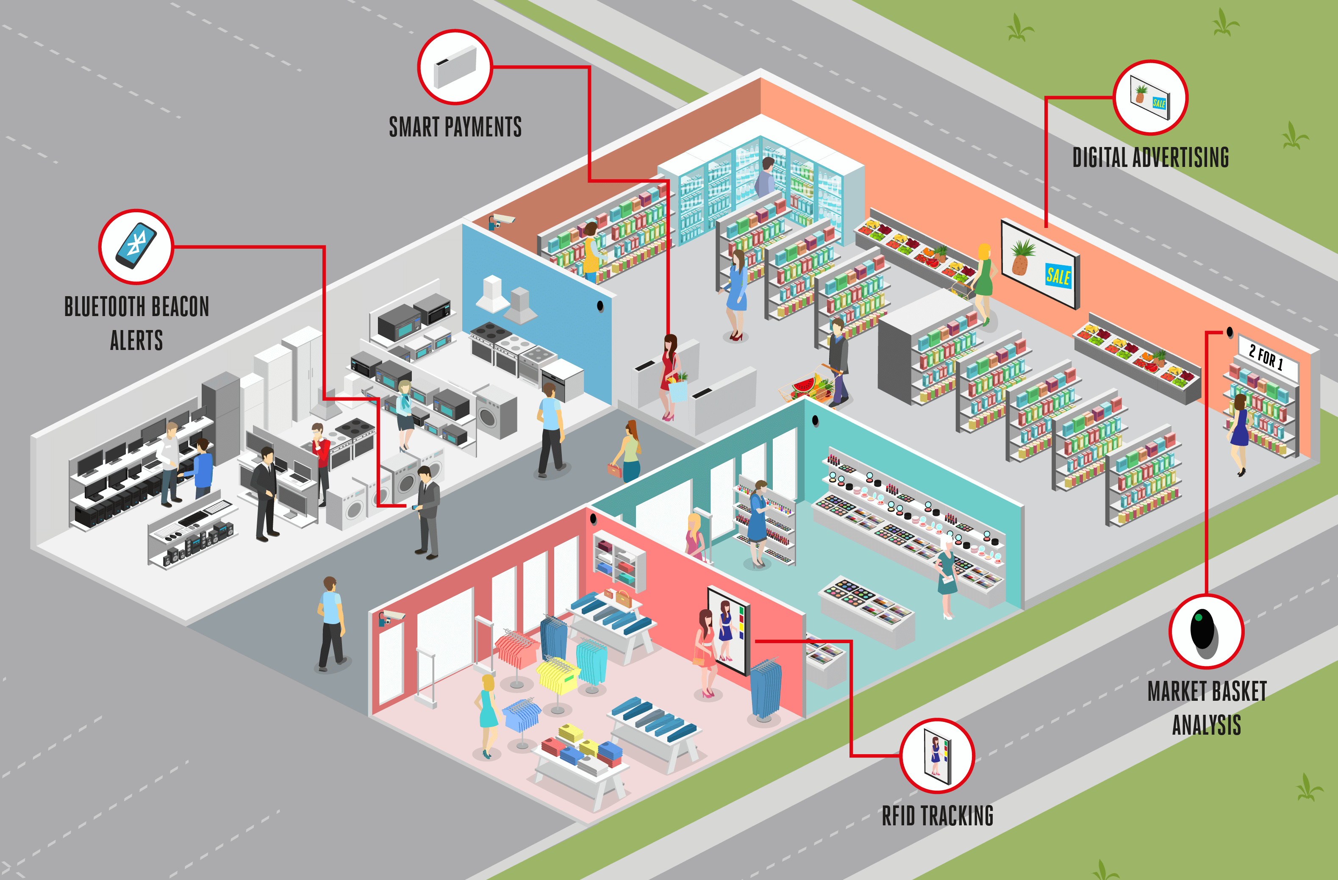
IoT Application in Retail
How it works?
All the sensor nodes and Beacons should be placed at various places in the store, washroom and parking area.
The sensor nodes should have Wi-Fi connectivity with controller nodes.
The sensor nodes sends the sensed data to the controller nodes.
The controller nodes
Collects the data from all the sensors,
Apply some business logic on it as per the requirements
Notes:
28

Slide 29
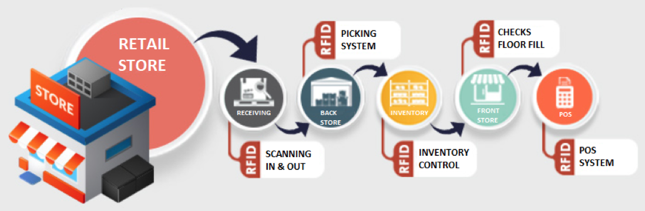
IoT Application in Retail
How it works?
RFID readers should be placed at items display shelves to detect item presence in the shelves for the stock management.
All the controller nodes and RFID readers should have connected with the Local Area Network.
RFID tags should be attached with each and every item which are likely to be monitored.
Using the RFID tags one can monitor location and stock of the item.
RFID tags is also useful for auto billing and queue less exit.
Notes:
29

Slide 30
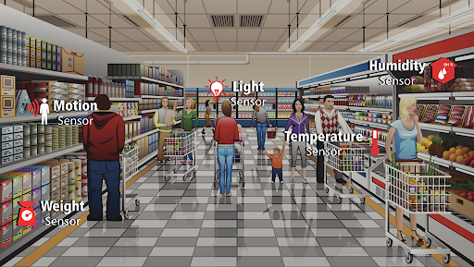
IoT Application in Retail
How it works?
Touch sensors are used for customers’ feedback about ambiance and cleanness at various places like washroom, trial room etc.
Light and Temperature sensors are used for ambiance monitoring which leads to energy saving and customer comfort.
Camera and IR sensors are placed for monitoring people density at various places, person in-out ratio for store and the parking area.
Gas sensors are used for monitoring various gases levels in the store.
Fire sensor are used for detecting fire in the store and send the alert signal to the Alarm & Water Sprinkler
Notes:
30

Slide 31
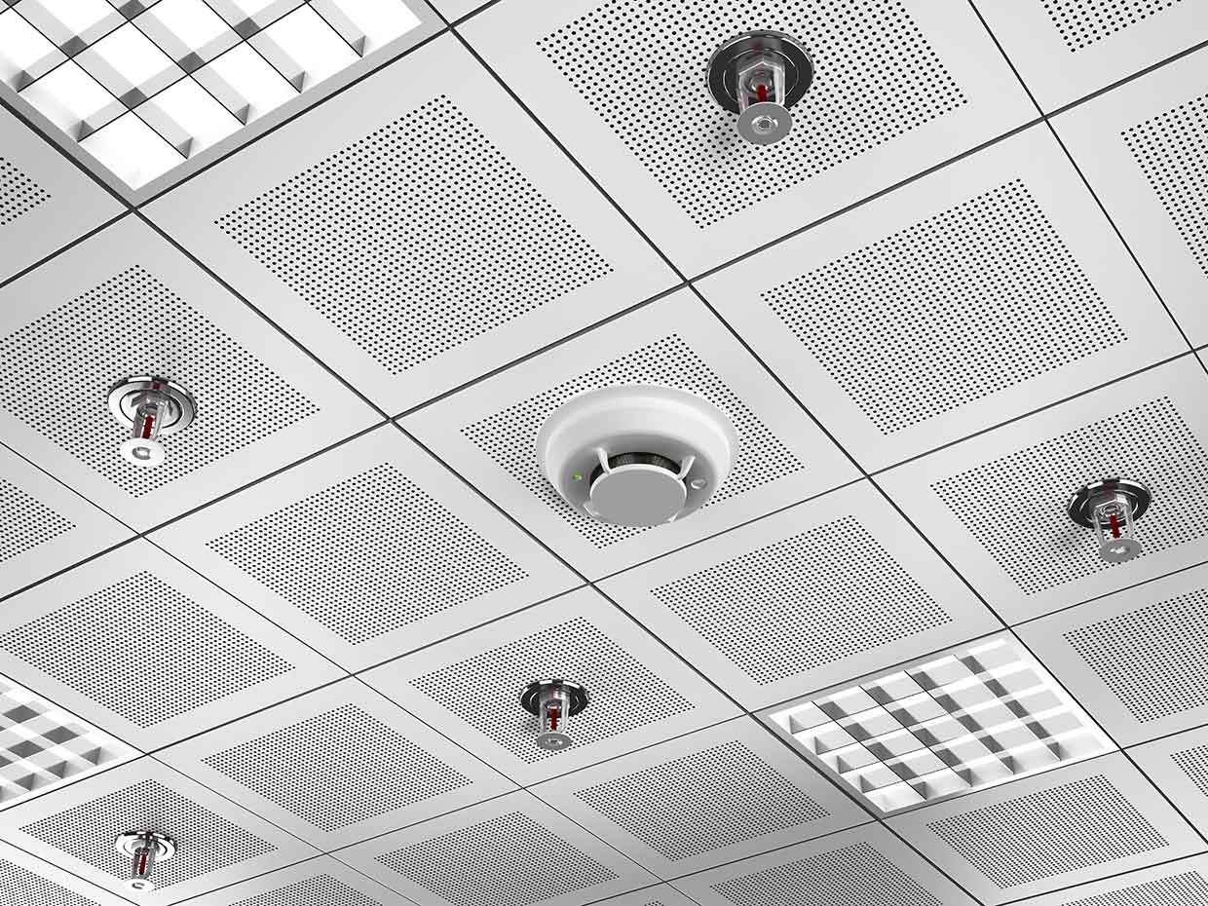
IoT Application in Retail
How it works?
An alarm system and the water sprinkling system are used for fire safety, should have connected with a controller node
Local Server
Receives all the data from all the controller nodes,
Execute some business logic and
Do analysis on the collected data, and
Send the essential data to the cloud computer.
The server computer should have Internet connectivity for the cloud communication.
The cloud
Stores all the data received from the local server,
Execute some business logic and
Do analysis on the stored data
Notes:
31

Slide 32
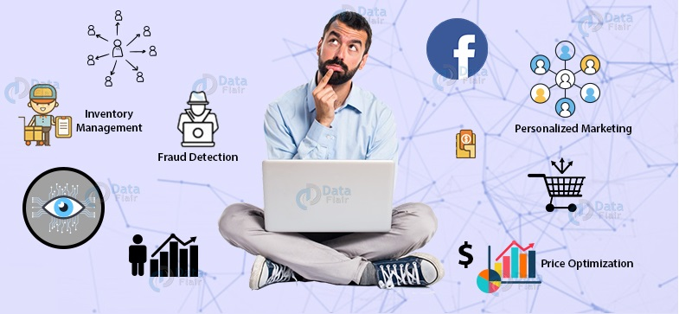
IoT Application in Retail
How it works?
All those who have rights to access the cloud data can get desire information and alerts, like
Store manager
Staff members
Data analytics team
customers
The store manager and data analytics teams may execute corrective action based on the data.
Notes:
32

Slide 33
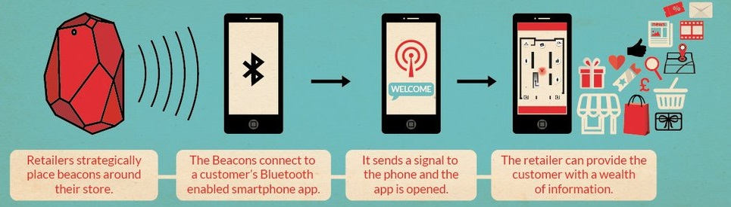
IoT Application in Retail
How it works?
Beacons, a Bluetooth Low Energy (BLE) device
Automatically connect with customers’ smartphones when they entered in the coverage area.
Send push notifications directly to the customers.
Beacons can be installed at various places
For customer in-store navigation,
To know foot fall in particular area of the store, and
Collecting data about customer behavior and routes.
Customers are notified about discounts and offers in real-time using the beacons system.
Notes:
33

Slide 34
IoT Application in Retail
Summary
IoT will dramatically transform and innovate the retail industry in the coming years.
The integration of IoT solutions will enable retail companies,
To create successful marketing campaigns based on customer behavior,
Deliver high-quality services,
Improve inventory management, and
Reduce operational costs.
Notes:
34

Slide 35
Driver Assistance
Section - 4

Slide 36
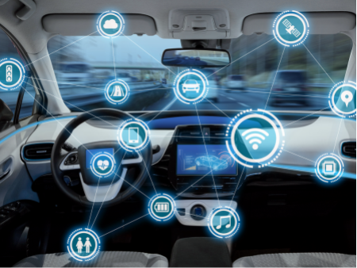
Driver Assistance Application with IoT
Overview
Vehicle manufacturing companies are trying to make vehicles more comfortable and safe for their passengers.
They are experimenting to design a system that could monitor and alert the user suffering from highway hypnosis or white line fever.
As well as they need an IoT based system to prevent accidents caused by drowsy driver.
Notes:
36

Slide 37
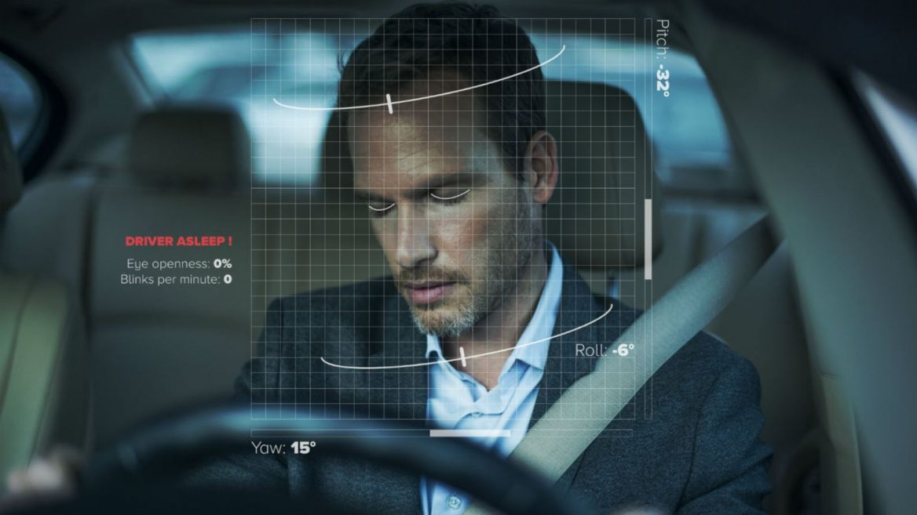
Driver Assistance Application with IoT
Importance
Driver’s drowsiness is one of the major factor is reported in road accidents.
Drowsiness is a kind of sleeping sensation which can lead for closing eyes.
Drowsiness make one physically inactive and insensitive to surroundings.
So we need to monitor driver’s consciousness along with his acceleration pattern and steering angle.
If any deviation is detected, a system should be there to alert the driver.
A process of detecting the deviation and drowsiness of the driver should be developed
Notes:
37

Slide 38
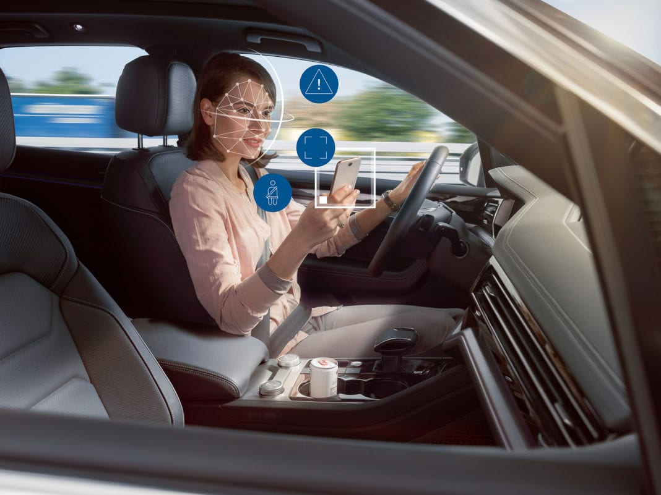
Driver Assistance Application with IoT
Importance
Using Image Processing and Machine Learning (ML) technology a system can be developed.
The system detect whether the driver has deviated or not, by monitoring the driver’s
Facial movements
Eye Aspects Ration (EAR) for drowsiness
Acceleration pattern
Change in the steering angle
Notes:
38

Slide 39
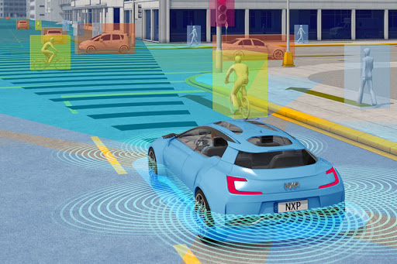
Driver Assistance Application with IoT
Requirements for IoT Setup
Sensors
Ultrasonic Sensor
Cameras
On Board Diagnostic (OBD) Access
Controlling
Raspberry Pi
For Monitoring and Analysis
PC
Mobile
Tablet
WAN Connectivity
Cloud Services
Notes:
39

Slide 40
Driver Assistance Application with IoT
Architecture
Drowsiness Detection System
EAR Value
Driver
Alert System
Internet
Camera Units
Camera
Facial Area
USB
Lane Detection
Wi-Fi / Bluetooth
Central and Remote
Storage/Analysis
Vehicle Computer
Cloud Services
Internet
Data Analytics
Internet Gateway
Speed
Variation
Within Vehicle for Local Analysis and Processing
Wired / Bluetooth
Research / Decision Making
Internet
OBD
On Board Diagnostics Unit
Bluetooth
Ultrasonic Sensor Nodes
Vehicle Owner
Steering Angle
Distance
Surrounding Vehicle
Deviation Detection System
Notes:
40

Slide 41
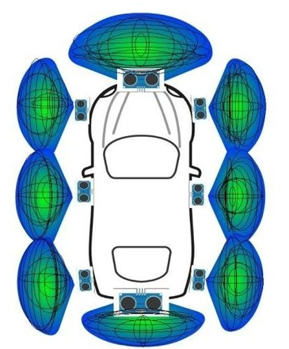
Driver Assistance Application with IoT
How it works?
Camera units should be placed on board for capture the face of driver and road view.
The camera units should have USB connectivity with vehicle computer.
The camera units sends the sensed data to the vehicle computer.
The ultrasonic sensor nodes should be placed at various place on outside the vehicle for detecting surrounding distance.
All the sensor nodes should have Wired / Bluetooth connectivity with the Vehicle Computer.
Notes:
41

Slide 42
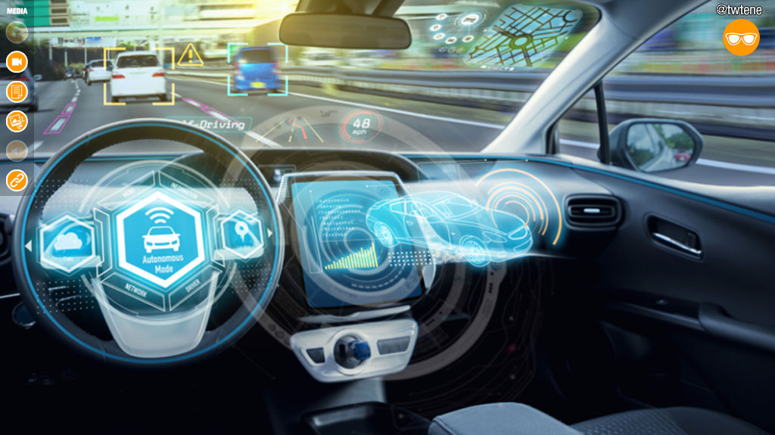
Driver Assistance Application with IoT
How it works?
The OBD unit of the vehicle should have Bluetooth connectivity with the vehicle computer
The vehicle computer
Collects the data from the camera units, OBD unit and the sensor nodes, and
Apply some business logic,
Do analysis on the collected data on it as per the requirements and
Send the filtered limited data to the cloud computer as well as
Send the alert messages to the driver.
The vehicle computer should have Internet connectivity for the cloud communication.
Notes:
42

Slide 43
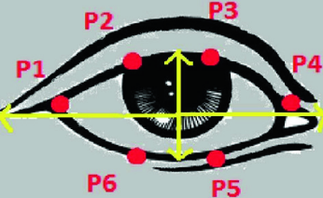
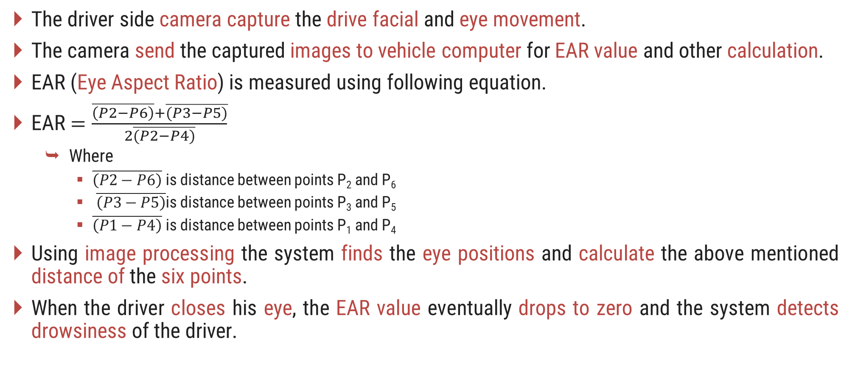
Driver Assistance Application with IoT
How it works?
The driver side camera capture the drive facial and eye movement.
The camera send the captured images to vehicle computer for EAR value and other calculation.
EAR (Eye Aspect Ratio) is measured using following equation.
EAR $=\frac{\overline{\left(P2−P6\right)}+\overline{(P3−P5)}}{2\overline{(P2−P4)}}$
Where
$\overline{\left(P2−P6\right)}$ is distance between points P₂ and P₆
$\overline{\left(P3−P5\right)}$is distance between points P₃ and P₅
$\overline{\left(P1−P4\right)}$ is distance between points P₁ and P₄
Using image processing the system finds the eye positions and calculate the above mentioned distance of the six points.
When the driver closes his eye, the EAR value eventually drops to zero and the system detects drowsiness of the driver.
Notes:
43

Slide 44
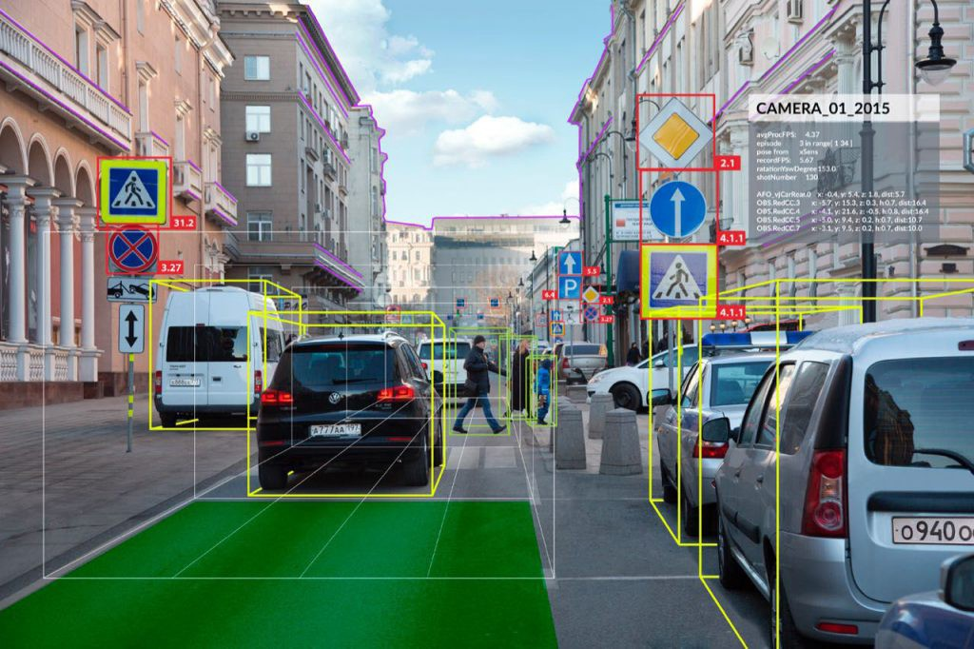
Driver Assistance Application with IoT
How it works?
The road side camera capture the front view images.
The capture images sends to the vehicle computer for
Detecting lane
Objects
Sign boards
Deviation is monitored using OBD (On-Board Diagnostics) device.
Notes:
44

Slide 45
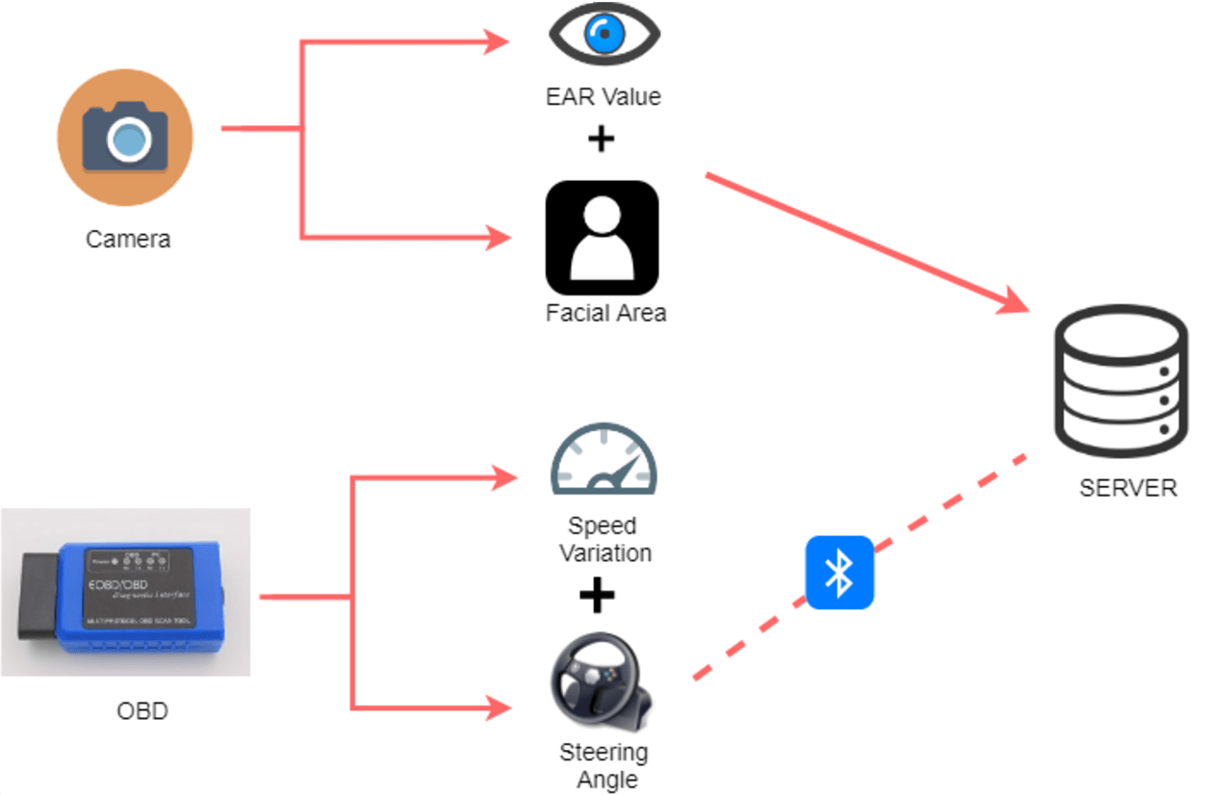
Driver Assistance Application with IoT
How it works?
OBD can record the pattern of acceleration and steering angles during the drowsiness of the driver.
Compare the recorded values with the threshold value and the historical data for the actual deviation.
All the calculated data is sent to the data analytics and obtained result, is used to alert the driver.
The cloud data also useful for the vehicle owner.
Notes:
45

Slide 46
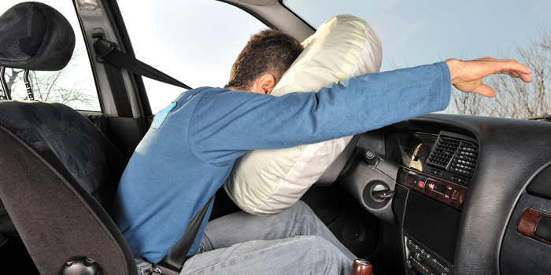
Collision Impact Detection Using IoT
Overview
Modern vehicles are equipped with the collision detection mechanism.
It blow up airbags when an accident occurs and save lives in major cases.
But if the collision is massive then the airbags may not sufficient.
In these cases emergency help needed to save the lives.
So we need a system that measure the severity impact of the collision and send alert message.
Notes:
46

Slide 47
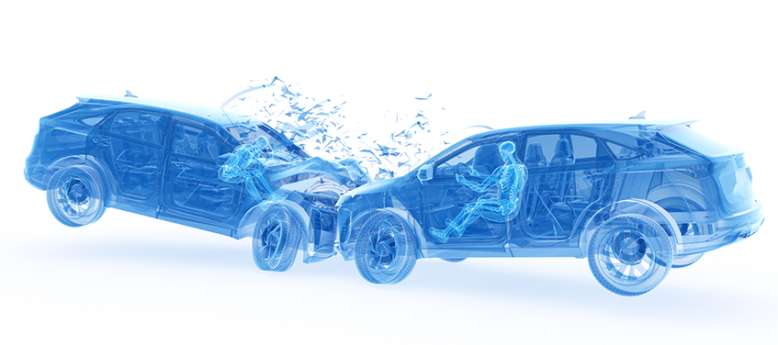
Collision Impact Detection Using IoT
Overview
The messages contents
Location of the accident
Severity impact,
Fire status,
Speed of the vehicle,
Number of passengers,
Time of the incident, etc.
Broadcast the messages to all the authorities like
Ambulance service,
Hospitals,
Highway patrolling team,
Fire brigade,
Police,
Family member of the vehicle owner, etc.
Notes:
47

Slide 48
Collision Impact Detection Using IoT
Importance
If a single accident occur in along highway then it can be managed without the data of severity of the collision.
When multiple accident occurs on the highway then the severity data is very important to save lives of the very serious victims.
Based on the data and severity impact, all the emergency help will be reached timely at the point.
Thus, we need an IoT based system that sense the necessary parameters of the collision.
Notes:
48

Slide 49
Collision Impact Detection Using IoT
Requirements for IoT Setup
Sensors
FSR Sensor
Fire Sensor
GPS Sensor
Cameras
OBD Access
Controlling
Raspberry Pi
For Monitoring and Analysis
PC
Mobile
Tablet
WAN Connectivity
Cloud Services
Notes:
49

Slide 50
Collision Impact Detection Using IoT
Architecture
For Location
Ambulance
Hospitals
Highway Patrolling
Fire Brigade
Police
For Passenger Counting
GPS
Node
Emergency Help
Service Provider
Camera Units
Camera
Passenger Count
USB
Wired / Bluetooth
Central and Remote
Storage/Analysis
Internet
Severity Impact
FSR
Sensor Nodes
Wired / Bluetooth
Vehicle Computer
Cloud Services
Internet
Data Analytics
Internet Gateway
Wired / Bluetooth
Within Vehicle for Local Analysis and Processing
Research / Decision Making
Internet
OBD
Speed
On Board Diagnostics Unit
Bluetooth
Vehicle Owner
Family
Fire
Sensor
Node
For Speed
For Detecting Fire
Notes:
50

Slide 51
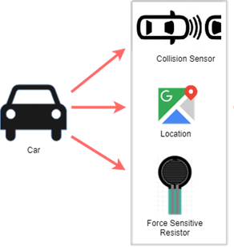
Collision Impact Detection Using IoT
How it works?
Force sensitive resistor (FSR) sensors are useful to measure pressure applied on the vehicle during the collision.
The FSR sensor are mounted on the vehicle at the places where impact probability is higher than the other part of vehicle during an accident.
Based on the FSR data we can estimate the severity of the collision.
Fire sensor and GPS should be placed at appropriate place of the vehicle.
All the sensor nodes should have Wired / Bluetooth connectivity with the vehicle computer.
Camera units should be placed on board for capturing all the passengers.
Notes:
51

Slide 52
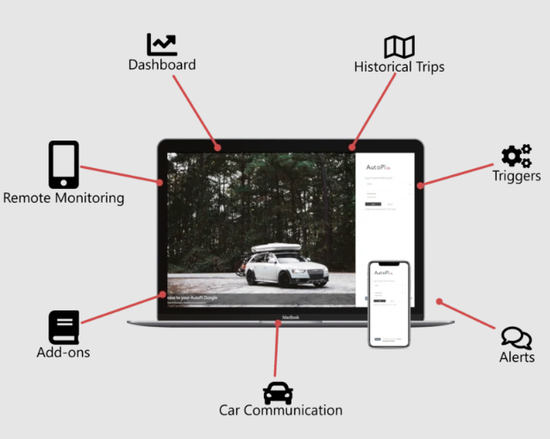
Collision Impact Detection Using IoT
How it works?
The camera units should have USB connectivity with vehicle computer.
The camera units sends the captured images to the vehicle computer.
The OBD unit of the vehicle should have Bluetooth connectivity with the vehicle computer
The vehicle computer
Collects the data from the camera units, OBD unit and the sensor nodes.
Apply some business logic,
Do analysis on the collected data on it as per the requirements.
Send the analyzed data to the cloud computer.
Should have Internet connectivity
Notes:
52

Slide 53
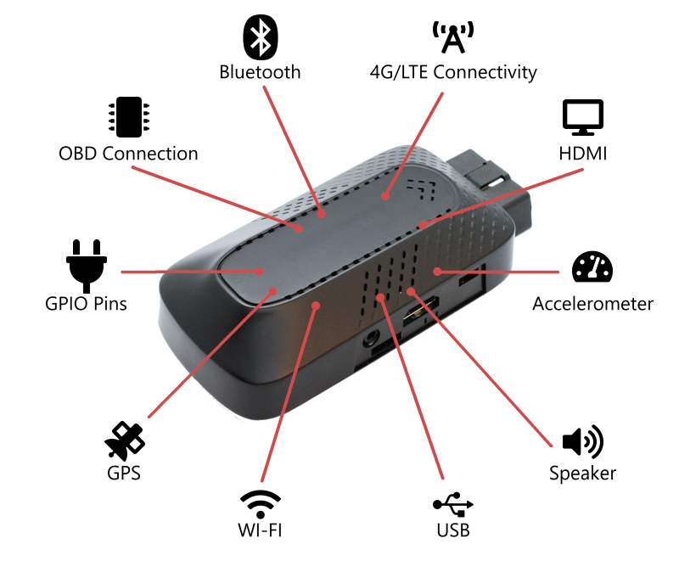
Collision Impact Detection Using IoT
How it works?
Using OBD (On-Board Diagnostics) device the system records speeds of the vehicle.
The fire sensor and GPS also sends the sensed data to the vehicle computer.
Based on the analyzed data and severity of the collision the cloud system sent alert messages to all the emergency help service provider and family member of the vehicle owner.
The cloud data is used for data analytics and to provide the priority based emergency services.
The system is automatic activated when the collision is detected.
Notes:
53

Slide 54
Water Quality Monitor
Section - 5

Slide 55
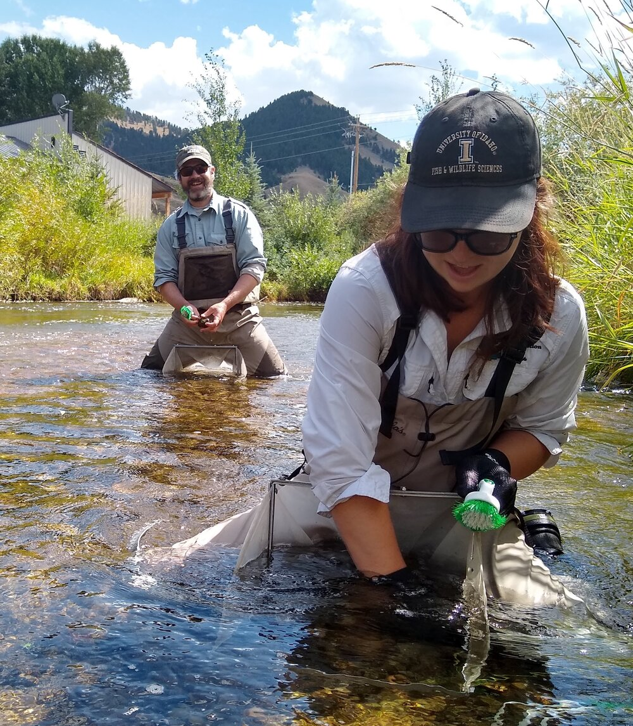
Water Quality Monitoring - IoT Based Application
Importance
At present water quality is monitored very expensive and inefficient by manual or nodal network methods
Manual Method
Water samples are taken manually from the different points of a water area.
The samples sent to laboratories
Various tests are conducted to find the values of
PH, Conductivity and Temperature
TDS, Dissolved Oxygen
Turbidity
Chloride Content
The reports of the test sends to the concern authorities with in a week.
Notes:
55

Slide 56
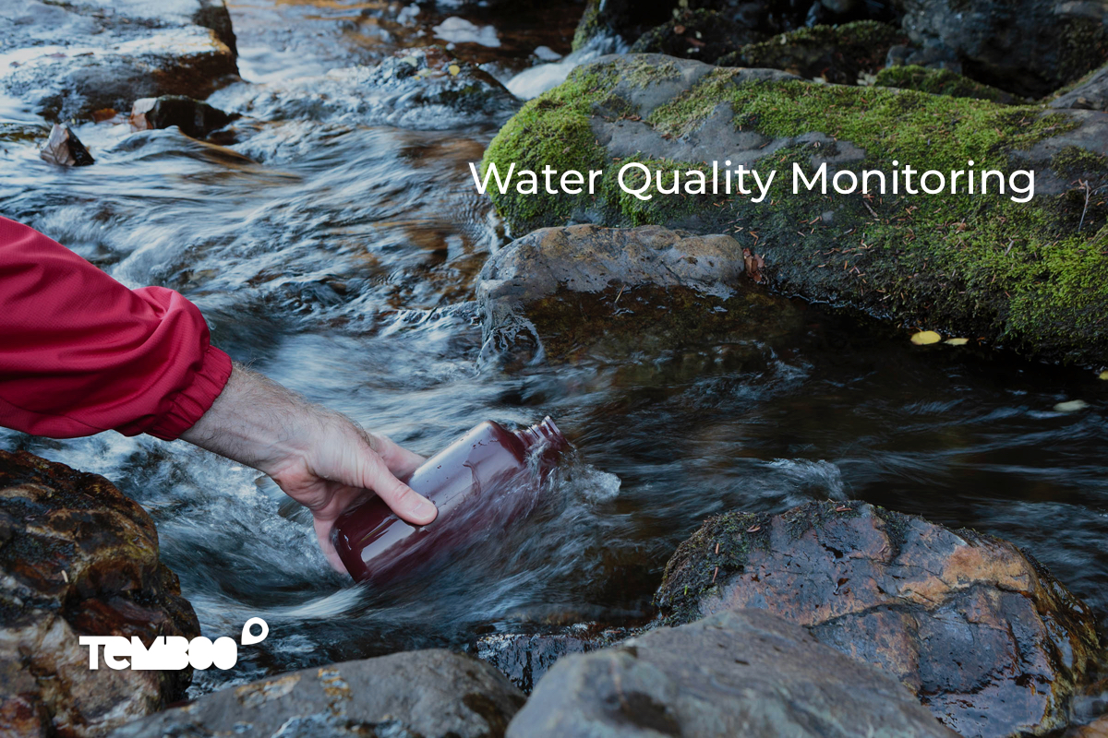
Water Quality Monitoring - IoT Based Application
Overview
Water is essential for life and the polluted water is a one of the major challenge in the world.
So water quality monitoring is necessary for us.
Water Quality Monitoring (WQM) helps in preventing and controlling water pollutions.
Water quality should be checked regularly to avoid serious health issues.
IoT can help to develop a perfect WQM system.
Notes:
56

Slide 57
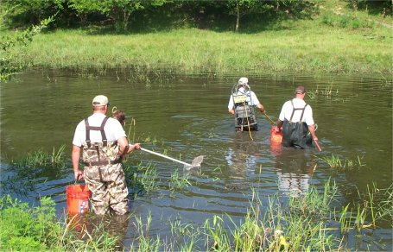
Water Quality Monitoring - IoT Based Application
Importance
Manual Method
The methods have some limitations like
Chance of human error in the sampling
Sampling cost is very high because of to cover very large area of waterbody
Sampling and Testing both are time consuming
Not real-time monitoring which leads to may serious issues.
Notes:
57

Slide 58

Water Quality Monitoring - IoT Based Application
Importance
Nodal Network Method (Electronics Sensor Monitoring)
Water quality is measured by electronic sensors installed in the different points of a water area.
All the sensors are wirelessly connected with the Internet.
The water quality data sends to the cloud server at regular interval.
This method is giving real-time data contras to the manual method.
System architecture of the monitoring system is divided into following four areas
Sensing
Data Collection
Processing
Communication
Notes:
58

Slide 59
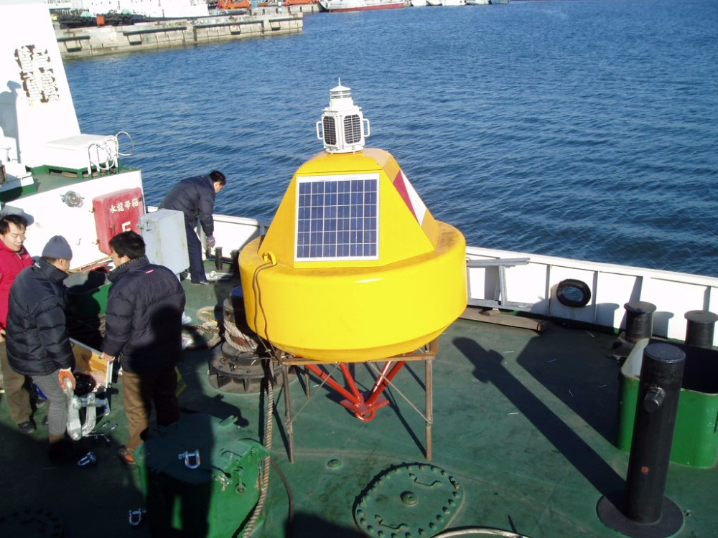
Water Quality Monitoring - IoT Based Application
Importance
Nodal Network Method (Electronics Sensor Monitoring)
The methods have following limitations
Very expansive
Maintenance of the sensors along with power source are challenging
Natural disaster and aquatic animal movement in the waterbody may damage the sensors
The sensors are not moveable
Notes:
59

Slide 60
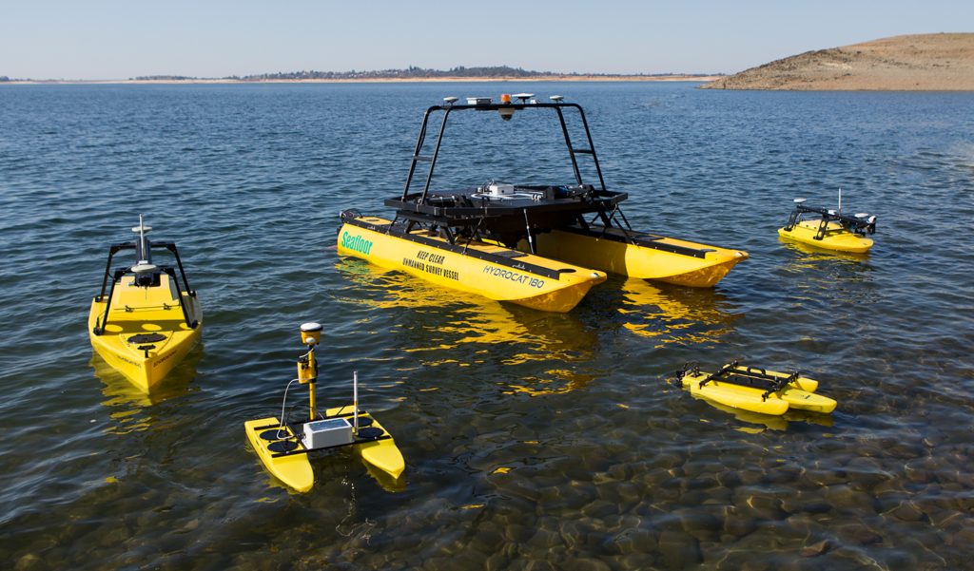
Water Quality Monitoring - IoT Based Application
Importance
A low cost solution is possible for WQM using latest technology, Data Analytics, USVs, Machine Learning, AI and IoT.
No need to install sensors permanently into the waterbody in the solution
An autonomous boat (USV), mounted with all the necessary sensors can
Collect the water quality data and
Send the data to the cloud for data analytics
All the necessary parameters of water can be tracked and measured.
Detailed report of the containment status of the entire waterbody can be generated.
Notes:
60

Slide 61
Water Quality Monitoring - IoT Based Application
Requirements for IoT Setup
Water Sensors Kit
For Monitoring and Analysis
PC
Mobile
Tablet
Temperature Sensor
Conductivity Sensor
PH Sensor
GPS Sensor
Turbidity Sensor
TDS and Dissolved Oxygen Sensor
Controller
ESP32 MCU or
Arduino Uno with Wi-Fi or Network Shield
WAN Connectivity
GPRS or GSM Module
Cloud Services
Unmanned Surface Vehicle (USV)
Notes:
61

Slide 62
Water Quality Monitoring - IoT Based Application
Architecture
Report Generation
Water Quality Sensors Kit
Pollution Control Board
Temperature Sensor
PH
Sensor
Central and Remote
Storage/Analysis
Internet
GPS Sensor
Sensors Kit Controller
Node
Wired
GPRS / GSM Module
Internet
Cloud Services
Internet
Data Analytics
Turbidity Sensor
Wired
Research / Decision Making
Internet
TDS and DO Sensor
Conductivity Sensor
USV
Control Panel
USV Controller Node
Base Station,
USV Operator
Unmanned Surface Vehicle
Notes:
62

Slide 63
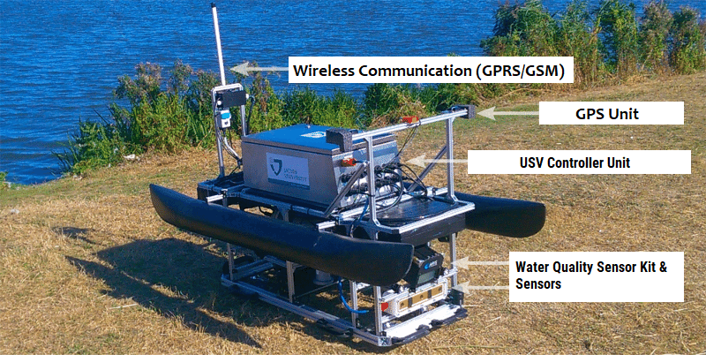
Water Quality Monitoring - IoT Based Application
How it works?
A bundle of all the sensors or a water quality sensor kit should be mounted on an autonomous or unmanned surface vehicle (USV).
The USV can be operated by an embedded controller node.
The USV should have GSM or GPRS internet connectivity with the cloud server.
The sensor kit sense the following values
PH Value of Water - PH Sensor
Temperature of Water - Temperature Sensor
Conductivity of Water - Conductivity Sensor
Clarity of Water - Turbidity Sensor
Dissolved Solid and Oxygen in Water– TDS and DO Sensor
Location of the reading - GPS Sensor
Notes:
63

Slide 64
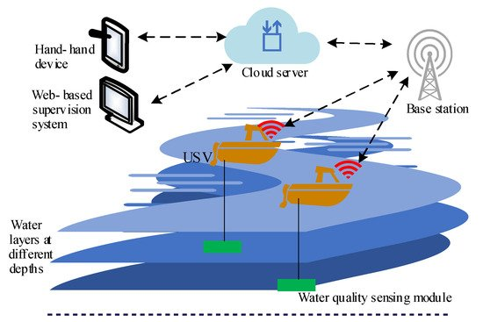
Water Quality Monitoring - IoT Based Application
How it works?
The kit controller node sends all the sensed data to the cloud server via GPRS/GSM module
The GPRS/GSM module is used to provide the Internet connectivity with the cloud server.
The cloud
stores all the data received from the USVs,
Execute some business logic and
Do analysis on the stored data.
All those who have rights to access the cloud data can get water quality records of the waterbody.
Like,
Members of Pollution Control Board
Data analytics team
USV operator
Notes:
64

Slide 65
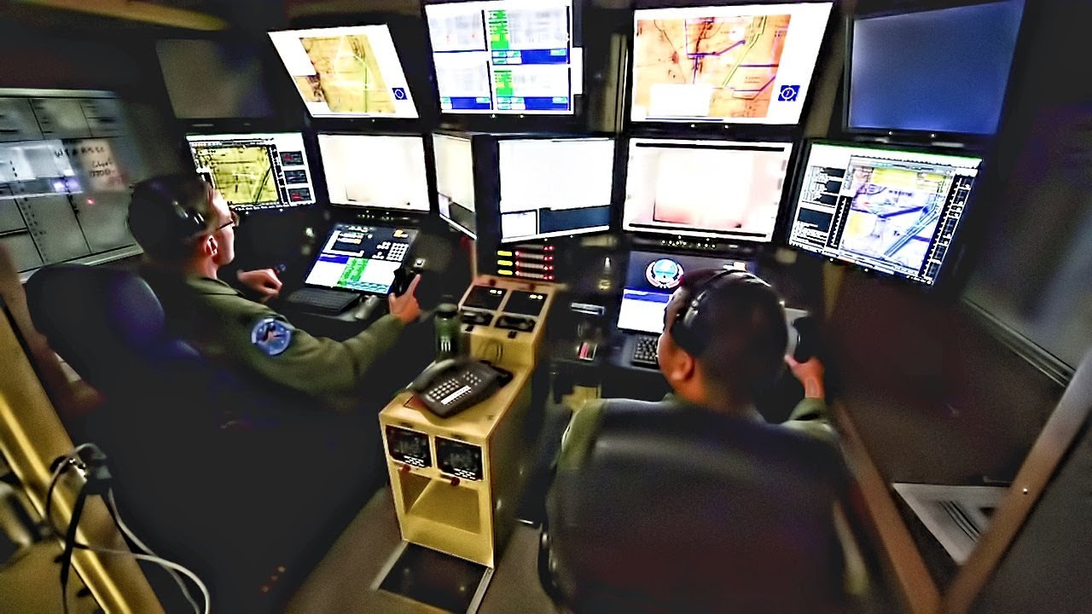
Water Quality Monitoring - IoT Based Application
How it works?
Authorities of the board and data analytics teams may execute corrective action based on the data.
An USV control panel is installed in the base station of the WQM system.
The control panel should have internet connectivity for controlling the USV.
Using the control panel, an operator can set paths and control the USV.
Notes:
65

Slide 66
IoT with Python
Section - 6

Slide 67
Introduction To Python : Python in IoT
Python’s popularity in IoT is attributed to its ease of use, an abundance of libraries and frameworks, and its versatility.
Python offers a rich set of tools and libraries that simplify IoT development.
Some of the best solutions for IoT in the Python programming language are as follows:
Python on Raspberry Pi
Python on PyBoard
ESP8266, ESP32 with Micropython

Slide 68
IoT Tools
Section - 7

Slide 69
IoT Tools
The variety of tools and platforms can be overwhelming when you’re just getting into IoT.
There are many Tools available for the development of the IoT System from prototyping to production, simple to sophisticated, open-source to commercial.
We can Classify tools as per the level of complexity like:
IoT Tools for Hobbyists and Small Projects
IoT Tools for Middle-Ranged Business Automation
Advanced IoT Tools for Enterprise and Smart Factories

Slide 70
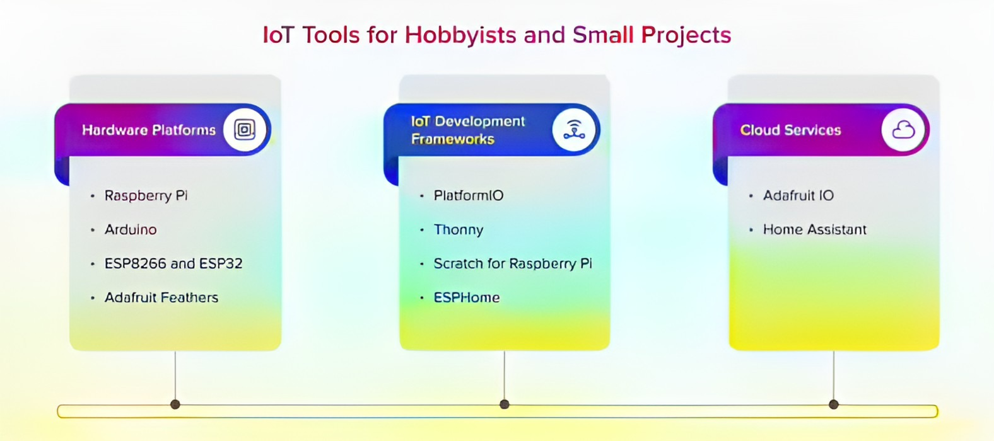
IoT Tools for Small Projects

Slide 71
Hardware Platforms
Raspberry Pi is a must-have for makers and coders. This tiny yet powerful computer can connect to sensors, actuators, and other hardware. Program it with Python, Scratch, or JavaScript for limitless possibilities.
Arduino is a go-to choice for prototyping with sensors and actuators. Its simple IDE and Wiring language make it perfect for beginners and pros alike. You can connect your Arduino to the cloud with ease.
ESP8266 and ESP32 are super affordable WiFi-enabled microcontrollers.
Program them in C/C++, MicroPython, or Arduino to build wireless projects quickly.
Adafruit Feathers are ready-to-use microcontroller boards with built-in WiFi and Bluetooth.
Simply plug in the sensors, run the code, and you’re ready to go. Their user-friendly design gets you prototyping in no time.

Slide 72
IoT Development Frameworks
Arduino IDE is the most popular IoT development framework, it is an open-source platform that makes creating hardware projects easy.
The intuitive interface and simple coding language C/C++ help quickly prototype your ideas.
PlatformIO is an open-source ecosystem for IoT development, supporting a vast range of development boards and microcontrollers. It also has a robust library manager, advanced debugging tools, and continuous integration.
Thonny is a beginner-friendly IDE for Python programming with a simple interface designed for learning.
Thonny is perfect for IoT projects using microcontrollers like the mentioned Raspberry Pi with the support of Python.
ESPHome is an open-source framework for home automation that lets you control your ESP8266/ESP32-based devices from any phone or tablet. ESPHome has a simple setup and integrates with popular smart home software.

Slide 73
Cloud Services
Adafruit IO is an easy-to-use cloud platform to store and retrieve data from sensors, actuators, and more.
Home Assistant is an open-source home automation platform that prioritizes local control and privacy. It is powered by an active developer community producing integrations for hundreds of devices. The platform enables you to automate your lights, sensors, appliances, and much more. Home Assistant can run on your hardware or in the cloud.

Slide 74
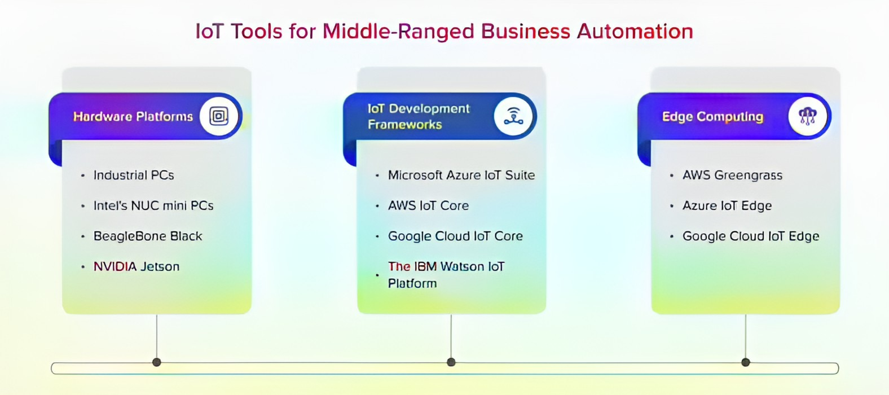
IoT Tools for Middle- Ranged Business

Slide 75
Hardware Platforms
Industrial PCs offer the stability, reliability, and longevity required for IoT edge devices.With features like extended temperature range, vibration resistance, and fast processors, industrial PCs can serve as the backbone of your IoT infrastructure.
Intel’s NUC (The Next Unit of Computing) mini PCs are perfect for IoT applications that require a small footprint but plenty of processing power. The wide range of models offers different connectivity options, CPU choices, and expandability to suit various IoT needs.
Being an open-source electronics platform powered by an embedded Linux board, the tiny BeagleBone Black is packed with useful features. It offers programmable GPIOs, a USB host, an Ethernet port, and more, making it ideal for building IoT prototypes and proof of concepts.
NVIDIA Jetson modules bring the power of AI and GPU acceleration to edge devices with features like HDMI output, USB 3.0, Gigabit Ethernet, and more

Slide 76
IoT Development Frameworks
Microsoft Azure IoT Suite is a comprehensive set of cloud services and APIs that helps you connect, monitor, and control billions of IoT assets.
You can collect data from IoT devices at any scale, analyze the data using Azure Machine Learning, and take action on the insights using business logic.
AWS IoT Core is used to connect IoT devices to the AWS Cloud.
It provides a managed cloud service that lets you easily supply and register millions of IoT devices and interact with them seamlessly and securely.
Google Cloud IoT Core is a fully managed service that will help you connect, manage, and ingest data from globally dispersed devices.
It provides a scalable, efficient, and economical IoT data pipeline to Google Cloud.
IBM Watson IoT Platform helps businesses collect and organize data from billions of connected devices.
It offers an open and scalable platform for quickly developing IoT applications and insights.

Slide 77
Edge Computing
AWS Greengrass is perfect for running local computing, messaging, data caching, and ML inference at the edge.
Deploy your cloud logic to connected devices so they can act locally on the data they generate while still using the AWS Cloud for management, analytics, and durable storage.
Run AI and custom business logic on edge devices with the same Azure services you use in the cloud. Azure IoT Edge extends Azure IoT to the edge of the network, enabling IoT solutions that deliver low latency to operate autonomously and access data where it’s created.
Google Cloud IoT Edge is a tool to deploy and run containerized services directly on edge devices to process data and act on it immediately. It brings AI and advanced analytics to the edge with on-device machine learning.
The future is smart, so get out there and start connecting!

Slide 78
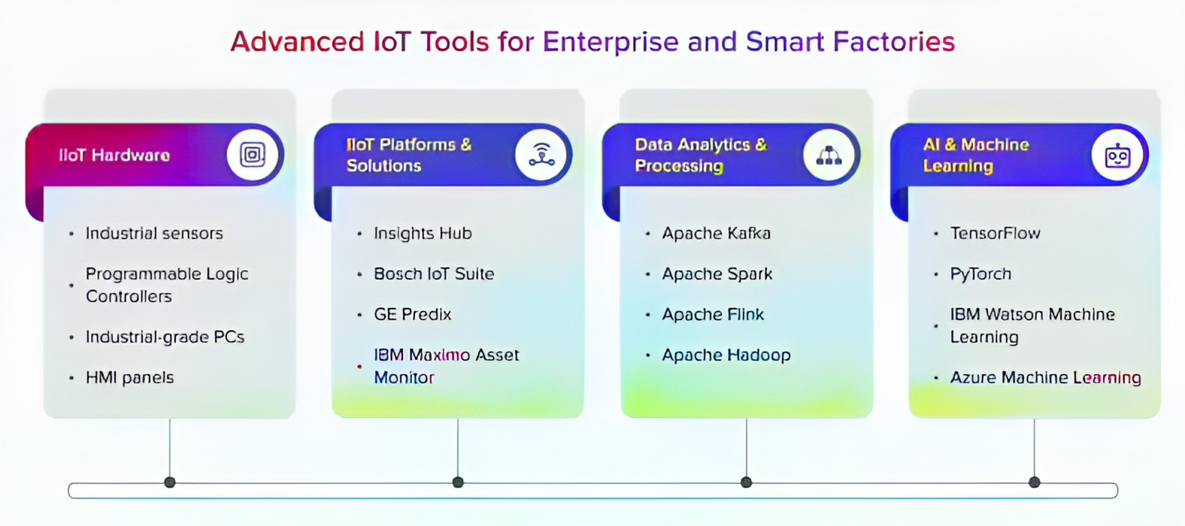
IoT Tools for Enterprise and Smart Factories

Slide 79
Industrial IoT (IIoT) Hardware
Get real-time data to power automation and predictive maintenance with industrial sensors designed to withstand harsh industrial environments.
Industrial Sensors will monitor critical parameters like temperature, pressure, vibration, and flow rate.
Programmable Logic Controllers (PLCs) act as the brains of your automation system, controlling machinery and processes.
The latest PLCs offer increased processing power, connectivity options, and advanced features to support IIoT applications.
Industrial-grade PCs serve as data collection and communications hubs, connecting machines to the industrial Internet.
Human-machine interface (HMI) panels provide operators with visual feedback and control of automation systems.
Modern HMIs feature intuitive touchscreens, advanced graphics, and IoT connectivity for remote monitoring.

Slide 80
IIoT Platforms & Solutions
Siemens MindSphere (now Insights Hub) is an advanced IIoT system that collects data from connected products and assets.
It then applies artificial intelligence and analytics to gain insights, optimizing processes and operations.
Bosch IoT Suite is a cloud-based platform connecting products and machines to the Internet of Things.
GE Predix is an industrial-grade operating system for the Industrial Internet that allows data from machines to be analyzed and used for optimization.
Predix collects data from assets and applies analytics and AI to generate insights that drive improvements in operations.
IBM Maximo Asset Monitor is a comprehensive solution that uses IoT sensors and AI to gain insights into the health and performance of physical assets.

Slide 81
IoT Application Development
Section - 8

Slide 82






Developing IoT Application
Hardware
Arduino UNO
Node MCU
IoT Development Framework
Arduino IDE
MQTT Server
Hive MQ
Raspberry Pi
Thonny

Slide 83
Cloud Computing and IoT
Section - 9

Slide 84


Introduction to Cloud Computing
Cloud computing : “Cloud computing is a model for enabling universal, convenient, on-demand network access to a shared pool of configurable computing resources (e.g., networks, servers, storage, applications, and services) that can be rapidly provisioned and released with minimal management effort or service provider interaction”.
Cloud computing is the delivery of computing services over the internet, by providing flexible, affordable, effective and efficient resources for development.
Application logic runs
on user’s computer
Application logic runs
in the cloud
Notes:
84

Slide 85
Benefits of Cloud Computing
The availability of virtually unlimited storage and processing capabilities at low cost enabled the realization of a new computing model.
Large companies (like Amazon, Google, Facebook, etc.) widely adopted this paradigm for delivering services over the Internet, gaining both economical and technical benefits.
Cloud computing model is attractive since it frees the business owner from the need to invest in the infrastructure, renting resources according to needs and only paying for the usage.
Cloud Computing allows to decrease operating costs, that includes servers, storage, databases, networking, software, analytics, and intelligence.
Notes:
85

Slide 86
Service Models of Cloud Computing
There are three main service models of cloud computing.
Infrastructure as a Service (IaaS)
Platform as a Service (PaaS)
Software as a Service (SaaS).
Each model represents a different part of the cloud computing stack.
Notes:
86

Slide 87
Cloud Computing Services
Software as a Service (SaaS).
SaaS provides application-level services.
It is tailored to a wide variety of business needs.
Such as
Customer relationship management (CRM)
Marketing automation
Business analytics.
Platform as a Service (PaaS).
Geared toward software development teams.
PaaS provides computing and storage infrastructure and also a development platform layer, with components such as
Web servers
Database management systems
Software development kits (SDKs) for various programming languages.
Infrastructure as a Service (IaaS)
IaaS provides users access to raw computing resources.
Such as
Processing power
Data storage capacity
Networking, in the context of a secure virtual data centre.

Slide 88

Cloud Computing Services - Transportation analogy
Notes:
88

Slide 89
Cloud Computing Services
Traditional
On-Premises
Infrastructure
as a Service (IaaS)
Platform
as a Service (PaaS)
Software
as a Service (SaaS)
Applications
Applications
Applications
Applications
Data
Data
Data
Data
Runtime & Middleware
Runtime & Middleware
Runtime & Middleware
Runtime & Middleware
OS
OS
OS
OS
Virtualization
Virtualization
Virtualization
Virtualization
Networking
Networking
Networking
Networking
Storage
Storage
Storage
Storage
Servers
Servers
Servers
Servers
You Manage
Vendor Manage
Notes:
89

Slide 90


Software-as-a-Service (SaaS)
Complete software application as a service is provided to the user that is run and managed by the service provider.
It can also be called application as a service as a pay monthly, yearly etc. subscription.
In SaaS, user don't need to worry about software up-gradation and management.
A common example of a SaaS application is web-based email where you can send and receive email without having to manage the server that the email program is written.
Notes:
90

Slide 91

Platform-as-a-Service (PaaS)
It provides a development environment to application developers.
Operating system, programming-language execution environment, database, web server, development tools, APIs, libraries, etc., will be provided by the cloud service provider.
Users have to build, manage and maintain the applications.
Application developers develop and run their software on a cloud platform instead of directly buying and managing the essential hardware and software layers.
AWS Lambda, Google App Engine, IBM Cloud Foundry, Oracle Cloud Platform, Red Hat-OpenShift, Zoho etc.
Notes:
91

Slide 92


Infrastructure-as-a-Service (IaaS)
IaaS provides access to computing hardware, networking features, and data storage space.
Where the consumer is able to deploy and run software, which can include operating systems and applications.
The consumer does not manage or control the underlying cloud infrastructure but has control over operating systems, storage, and deployed applications.
This service provides the highest level access.
Notes:
92

Slide 93

Cloud Computing Services Examples

Slide 94
Types of Cloud Based on Services
Software-as-a-Service (SaaS):
Complete software application as a service is provided to the user.
It is application as a service as well, pay monthly, yearly etc. as subscription
Platform-as-a-Service (PaaS):
Development tools, APIs, libraries etc. will be provided by the cloud service provider.
Users have to build, manage and maintain the applications (provides platform to develop)
Infrastructure-as-a-Service (IaaS):
Virtual Machines kind of support.
Users shall manage the machines.
Users shall select the OS and underlying applications.
PAY as YOU use! (with IaaS approach, you choose virtual machines over physical machines)

Slide 95

Fog Computing
Cisco coined the term fog computing (or fogging) in 2014, so it is new to the general public.
Fog and cloud computing are inter-twined.
In nature
Fog is closer to Earth than clouds
In the tech world, it's the same;
Fog is closer to end-users, bringing cloud capabilities to the ground.

Slide 96

Fog Computing
Fog is an extension of cloud computing that consists of multiple edge nodes directly connected to physical devices.
The considerable processing power of edge nodes allows them to compute large amounts of data without sending them to distant servers.

Slide 97


Data Flow – Smart Farm IoT System
Data Flow
Cloud Provider
Fog Devices
Microcontroller node
IoT Sensor
Farm

Slide 98


Fog Computing vs. Cloud Computing
Fog Computing
Multiple Nodes and Nodes Connected to cloud
Cloud Computing
Directly the End-Devices are connected to Cloud

Slide 99

How it Works?
An IoT system consists of sensors/devices which “talk” to the cloud through some kind of connectivity.
Once the data gets to the cloud, software processes it and then might decide to perform an action, such as sending an alert or automatically adjusting the sensors/devices without the need for the user.

Slide 100

IoT Clouds

Slide 101
IoT Application Development with IoT Cloud (Blynk)
Section - 10

Slide 102


Developing IoT Application with IoT Cloud
Hardware
Arduino UNO
Node MCU
IoT Development Framework
Arduino IDE
IoT Cloud
Blynk
Arduino IoT Cloud
Raspberry Pi
Thonny

Slide 103








IoT Cloud - Blynk
Blynk is a full suite of software, required to prototype, deploy, and remotely manage connected electronic devices at any scale: from personal IoT projects to millions of commercial connected products.
Blynk is a Cloud service with Paas type.
Fogwing
Google Cloud IoT Core

Slide 104
Blynk Cloud
Blynk is considered a Platform as a Service (PaaS).
It provides a cloud-based platform for developers and businesses to build, deploy, and manage connected electronic devices.
Blynk provides the infrastructure to develop users' own IoT applications on top of Blynk's core functionalities rather than just providing a pre-built software service like a SaaS would.

Slide 105

Blynk Cloud Service for IoT
Blynk is a comprehensive software suite that enables the prototyping, deployment, and remote management of connected electronic devices at any scale.
Blynk empowers users to connect their hardware to the cloud and create iOS, Android, and web applications, analyze real-time and historical data from devices, remotely control them from anywhere, receive important notifications, and much more.

Slide 106
Components of the Blynk IoT Platform
Blynk.Console
Blynk.Apps
Blynk.Edgent &
Blynk Library
Edge + Agent = Edgent
Blynk.Cloud

Slide 107
What You Need to Start Blynk
A Smart Phone with
Android OS v4.2 +
iOS v9+
Arduino like Board (For connecting with Cloud)
Blynk Board
ESP8266 Board (NodeMCU, WeMos D1, Witty Cloud )
IoT Hardware (For Sensor and Actuators)
Hardware Modules (any model) with Sensor and Actuators
ESP32
Nordic nRF51/nRF52
Arduino (any Model)
Raspberry Pi (any model)
Modules like:

Slide 108
Include Header file/ Library for Blynk

Slide 109

Blynk Authentication & initialization
We need to give the Proper Template Id and Authentication token for the Device identity and connectivity with Blynk Cloud :
To Start the communication with Blynk Cloud we have to call Blynk.begin method:
void setup()
{ // Debug console
Serial.begin(115200);
// Begins the Serial Communication with 115200 baudrate
Blynk.begin(auth, ssid, pass);
// Begins the communication with Blynk Cloud
}
void loop()
{
Blynk.run();
// Write Your Loop Code Here
}

Slide 110
Read the value from Virtual Pin
BLYNK_WRITE()
This function used to read the changes or current value from dashboard.
Once the value is received from the Dashboard, we can process it for further changes on Hardware board.
BLYNK_WRITE() function is called every time the Virtual Pin 1 state changes.
BLYNK_WRITE() function reads the value of virtual variable from the Dashboard.
BLYNK_WRITE(V0)//V0 Virtual pin V0
{
// Set incoming value from pin V0 to a variable
int value = param.asInt();
}

Slide 111
Write the Value on Virtual Pin
Blynk.virtualWrite(Vpin, value)
This function used to send the data to the Dashboard.
This function will send value or variable from Arduino board to Dashboard.
Syntax:
Blynk.virtualWrite(Virtual pin, value)
Virtual Pin : Virtual Pin number assigned to particular widgets.
Value : variable or any static value
// You can send any value at any time.
Blynk.virtualWrite(V1, 10);
// Here we Write Value 10 to pin V1

Slide 112
Demo Code : Blynk Cloud with NodeMCU -1
BlynkNodeMCU.demo
1
2
3
4
5
6
7
8
9
10
11
12
13
14
15
16
17
// Template ID, Device Name and Auth Token are provided by the Blynk.Cloud
// See the Device Info tab, or Template settings
#define BLYNK_TEMPLATE_ID "TMPLSU_PLFEC"
#define BLYNK_DEVICE_NAME "Quickstart Device"
#define BLYNK_AUTH_TOKEN "Zk6hlVfK1Ohi5Y8vWwy47gWnJCZf-c5d"
// Comment this out to disable prints and save space
#define BLYNK_PRINT Serial
#include <ESP8266WiFi.h> //Header File for the ESP8266 Wi-Fi Module support
#include <BlynkSimpleEsp8266.h> // Library file for the Blynk cloud support for //ESP8266
char auth[] = BLYNK_AUTH_TOKEN;
// Your WiFi credentials.
// Set password to "" for open networks.
char ssid[] = “IoT_Demo";
char pass[] = “diet@iot";

Slide 113
Demo Code : Blynk Cloud with NodeMCU -2
BlynkNodeMCU.ino
18
19
20
21
22
23
24
25
26
27
28
29
30
31
32
33
34
// This function is called every time the Virtual Pin 0 state changes
BLYNK_WRITE(V0)
{
// Set incoming value from pin V0 to a variable
int value = param.asInt();
// Update state to the V1, virtual pin
Blynk.virtualWrite(V1, value);
}
// This function is called every time the device is connected to the Blynk.Cloud
BLYNK_CONNECTED()
{
//
}

Slide 114
Demo Code : Blynk Cloud with NodeMCU -3
BlynkNodeMCU.ino
30
31
32
33
34
35
36
37
38
39
40
41
42
43
44
45
void setup()
{
// Debug console
Serial.begin(115200); // Begins the Serial Communication with 115200 baudrate
Blynk.begin(auth, ssid, pass); // Begins the communication with Blynk Cloud
}
void loop()
{
Blynk.run();
// You can inject your own code or combine it with other sketches.
// Check other examples on how to communicate with Blynk. Remember
// to avoid delay() function!
}

Slide 115
Internet of Things (IoT)
DU #2101CS631
Prof. Bhushan D. joshi
Computer Engineering Department
bhushan.joshi@darshan.ac.in
+91 8485979997

